Slide 1
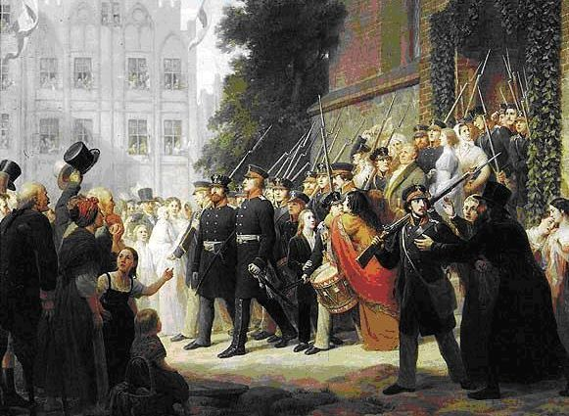
War in Germany 2018
Adam Tooze
Lecture 8 Thinking Napoleonic War: Clausewitz and history

Slide 2
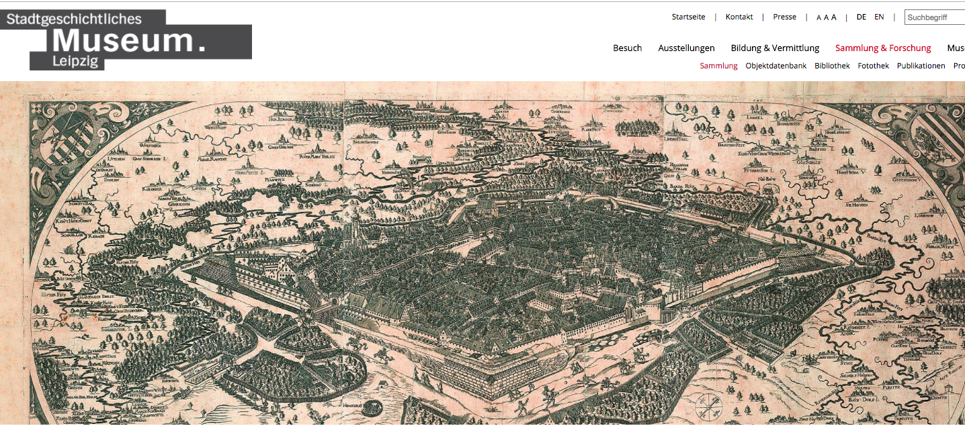
http://www.stadtgeschichtliches-museum-leipzig.de/sammlung-forschung/sammlung/

Slide 3
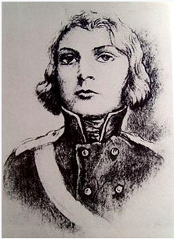
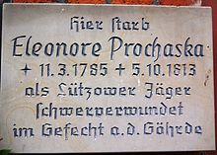
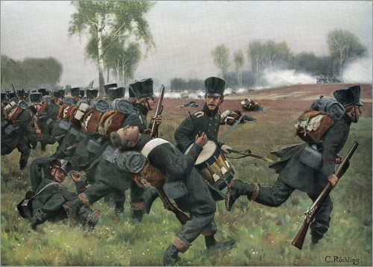
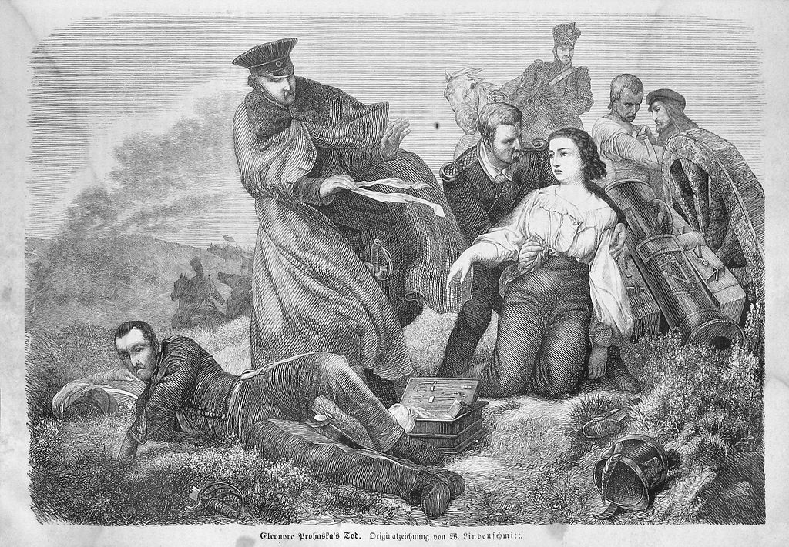

Slide 4
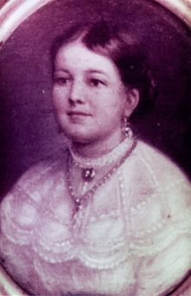
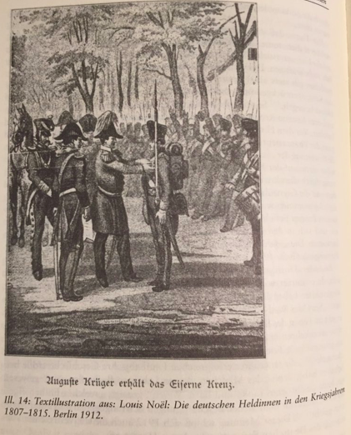
Auguste/Fridericke Krüger she served disguised as a man during the Napoleonic Wars in Germany from 1813 to 1815 in the first company of the Kolbergsches Infanterieregiment (renamed the 9th Grenadier regiment in 1914). Trained as a tailor, at 23 years old she cut off her hair, put on a male costume she had designed herself and obeyed a mobilisation proclamation. Owing to the speed of mobilisation there were no medical examinations and so she was not discovered at first. Her comrades admired her courage very much and were loyal to her, but during one attack her high voice caused the others to realize that she was female. However, she had got into favour with Bravour and so she was not ejected from the army. Indeed, she was even promoted to corporal after the Battle of Möckern. She was promoted to Sergeant after the battle of Dennewitz and subsequently fought in the battle of Waterloo in 1815.

Slide 5
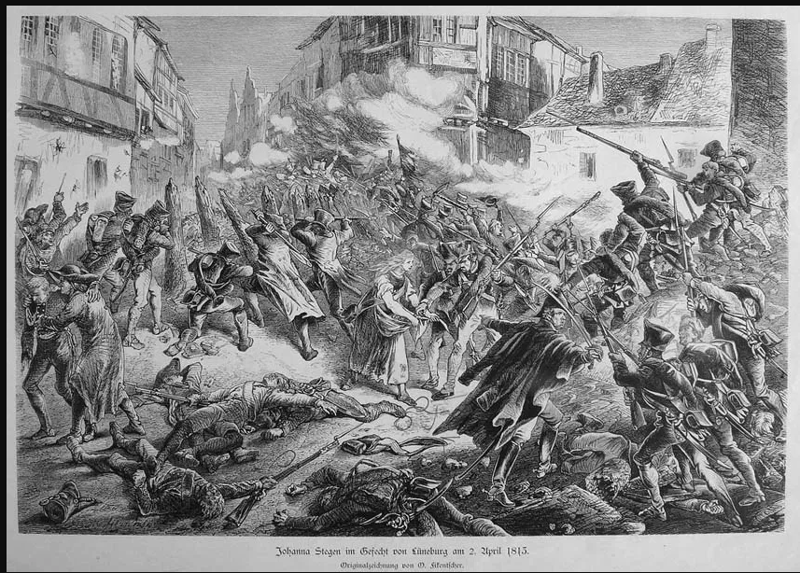
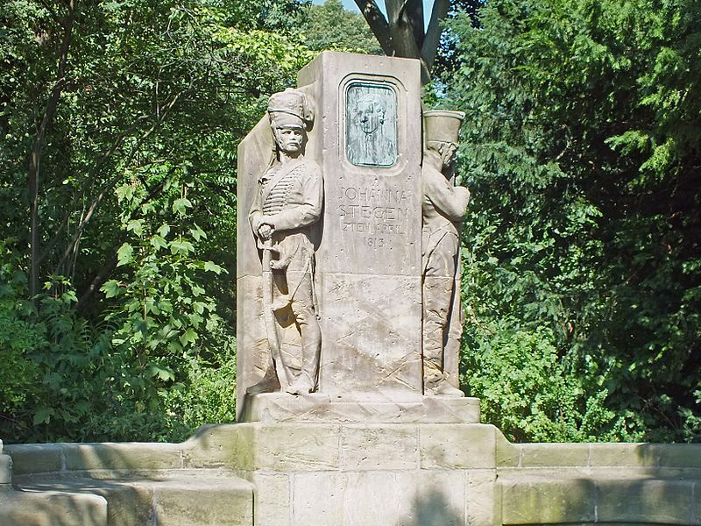
Johanna Stegen, the Heroine of Lüneburg, history painting of 1887 On 2 April 1813 German troops (made up of the fusiliers and volunteer Jägers of the 1st Pommerschen infantry regiment) clashed with Napoleonic troops near Lüneburg. In the course of the battle, the Prussian regiment risked running out of ammunition and so Johanna rushed ammunition to them in her apron, thus significantly contributing to the Prussian victory.

Slide 6
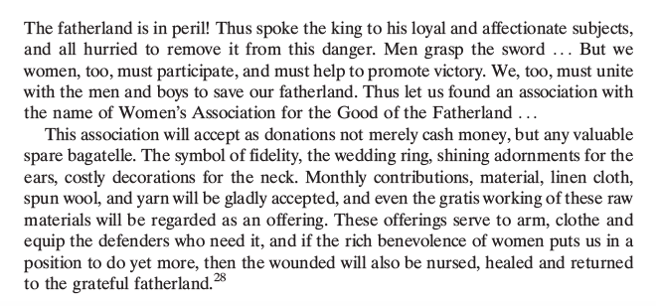
Appeal to the Women of the Prussian
State’ published on 23 March 1813 by twelve princesses of the house of
Hohenzollern under the leadership of Princess Marianne of Prussia

Slide 7
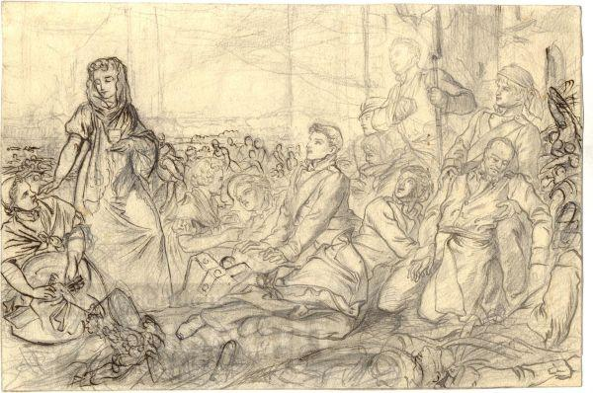
Tending for the wounded at Leipzig 1813 - Strassberger, 1813

Slide 8
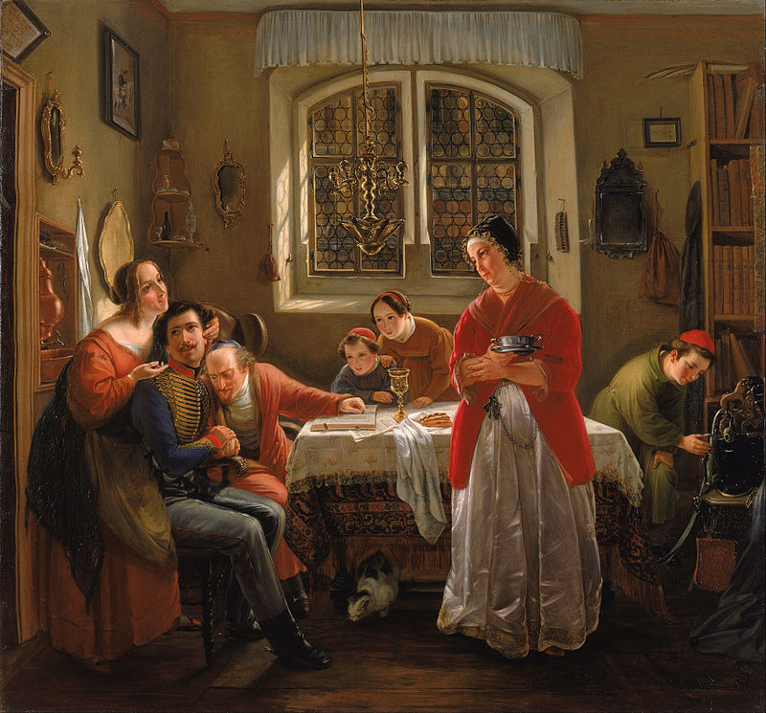
A “traditional” Jewish family welcomes home their veteran from the wars of liberation:
Die Heimkehr des Freiwilligen aus den Befreiungs-kriegen zu den nach alter Sitte lebenden Seinen (1833/34, Moritz Daniel Oppenheim)
History happened in popular imagination.

Slide 9
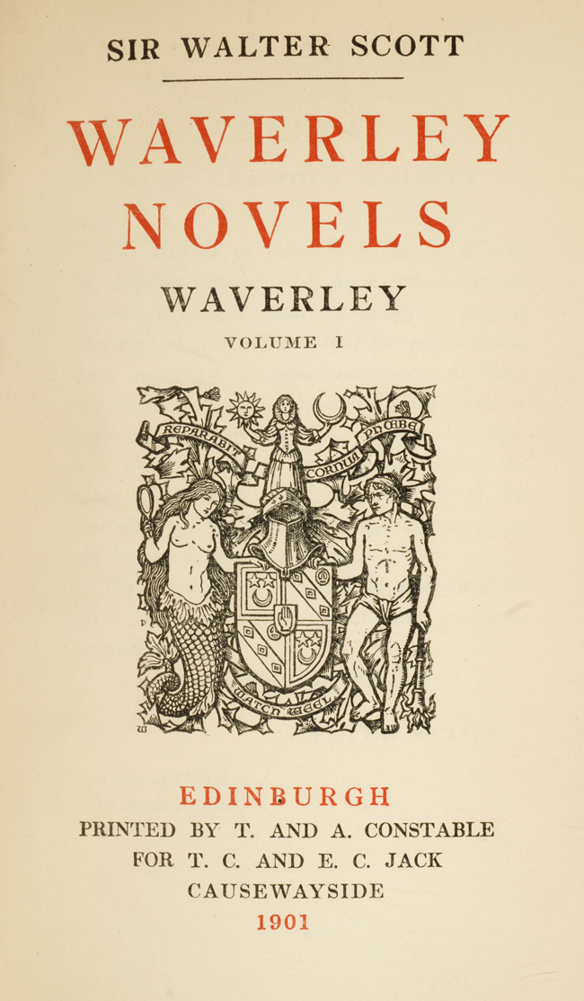
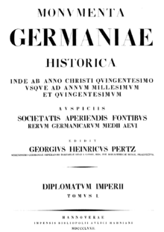
Early 19th century = breakthrough period for historical consciousness as we know/knew it
Grimm brothers collection of folklore first ed 1812
First collection of archival documents of “German medieval period” est 1819 by von Stein
Sir Walter Scott’s Waverley (1814) = historical novel bestseller

Slide 10
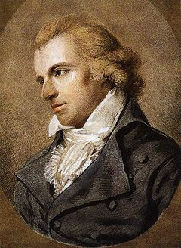
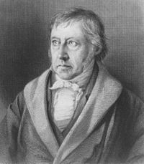
Georg Wilhelm Friedrich Hegel (1770–1831): history is not the soil in which happiness grows. The periods of happiness in it are the blank pages of history";^{[4]} "History as the slaughter-bench" (Geschichte Als Schlachtbank
Professor of Philosophy at Berlin 1818-1831
Friedrich Schiller (1759-1805): Weltgeschichte ist das Weltgericht – World history is the final court (world court)
Professor of philosophy and history at Jena 1789-1805

Slide 11
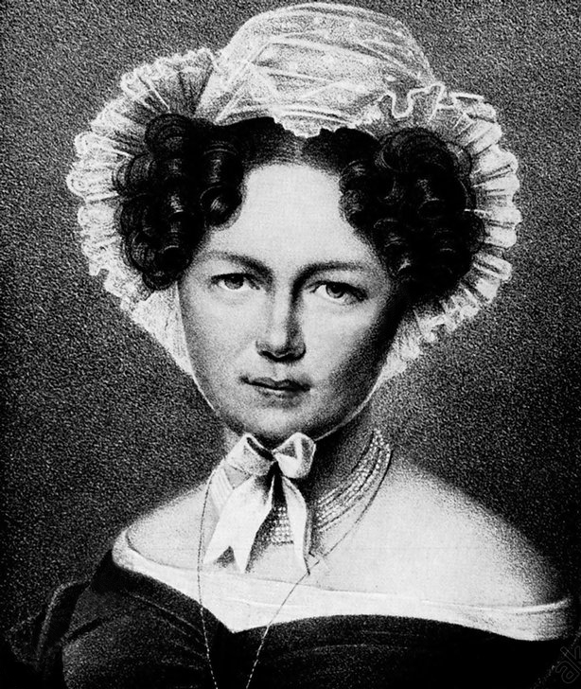
Countess Marie von Brühl 1779-1836
Patriot
Salonniere in French occupied Berlin 1806-1810.
Close friend of Princes Marianne
Passionately anti-French
Falls in love with a younger officer far below her rank. Her mother dismissed the affair as “like something out of a novel”
Persuaded her reluctant mother and her friends including PM Stein to accept her marriage because her young man was close friend of Scharnhorst one of the most glamorous of the Prussian military reformers.

Slide 12
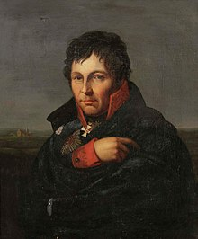
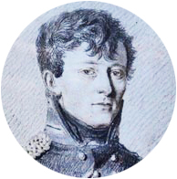
Gerhard von Scharnhorst the icon of romantic proto-nationalist German militarism – Hanoverian fighting for Prussia (and Russia) v. France
Marie’s young officer was Carl von Clausewitz Scharnhorst’s favorite pupil.
Without Marie, Carl would have remained enclosed in his own time. He would have been a bit player in the drama of 1806-1815 not what he became.
Marie von Clausewitz – née Countess von Brühl “staff officer” and editor of On War

Slide 13
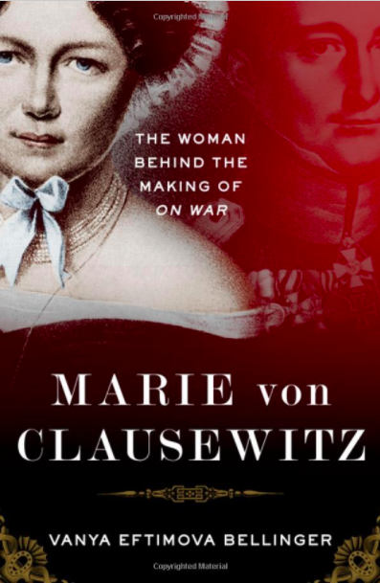

Slide 14
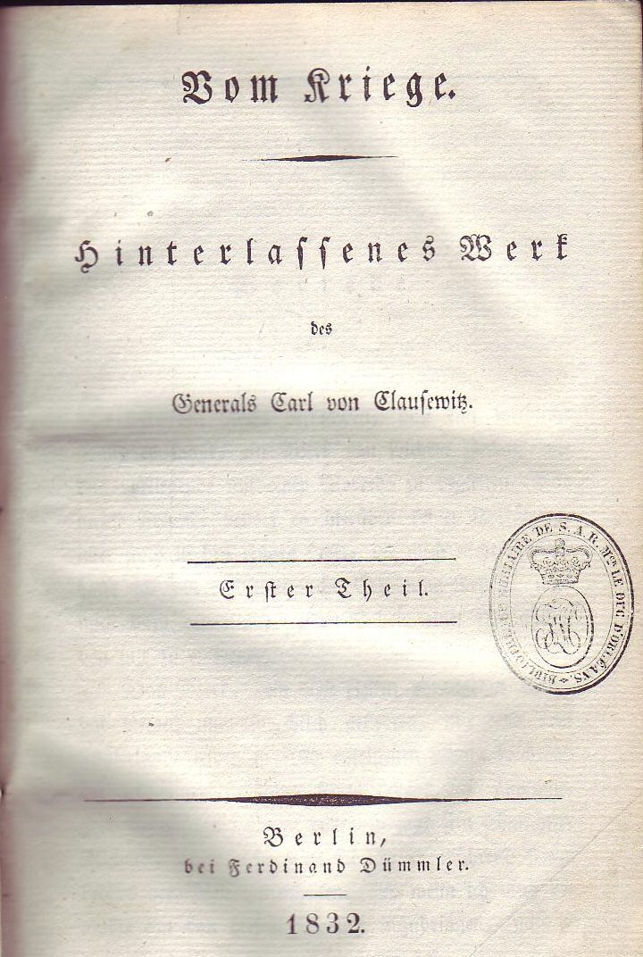
When Carl died in 1831 shipwrecked in an age that had moved on beyond the days of their youth, Marie von Clausewitz edited his unfinished master piece and published it.
It was read only by inner most circle of Prussian military.
By 1859 when 2nd edition brought out the 1st 1500 copies had not sold.
In 1869 Clausewitz featured in Tolstoy’s war and peace not as author of On War but as protagonist in drama of 1812
It is Franco-Prussian war 1870/71 and then 1914 that made him famous/infamous as inspiration of German general staff
→ Clausewitz is like Nietzsche and Wagner – a “dangerous mind”

Slide 15
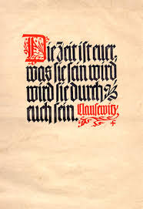
Nazis loved him
'Who liberated Germany? 1813', Hitler scribbled in his notes for a speech already in the twenties. 'Not the host of the meek, but the hardheads. Not the Simons - Wirts - Erzbergers - Rathenaus, (Weimar era advocates of fulfilling Versailles) but the Bluchers, Scharnhorsts, Yorcks and
Gneisenaus. The spirit that Clausewitz expressed in a pamphlet: Clausewitz's Bekenntnis.”
'Thus Clausewitz stretches out his hand to us over the civilian nineteenth century', wrote a fledgling National
Socialist scholar in his Heidelberg dissertation from 1934.
These times are yours. What they will be, they will be through you.”

Slide 16
Clausewitz’s political manifesto of 1812 is translated into English as his “Declaration” – Bekenntnis actually means “Credo”
Clausewitz’s political manifesto of 1812 is read out on German radio for new years 1944
Hitler invokes Clausewitz is his Last Testament to Admiral Dönitz (1945)

Slide 17
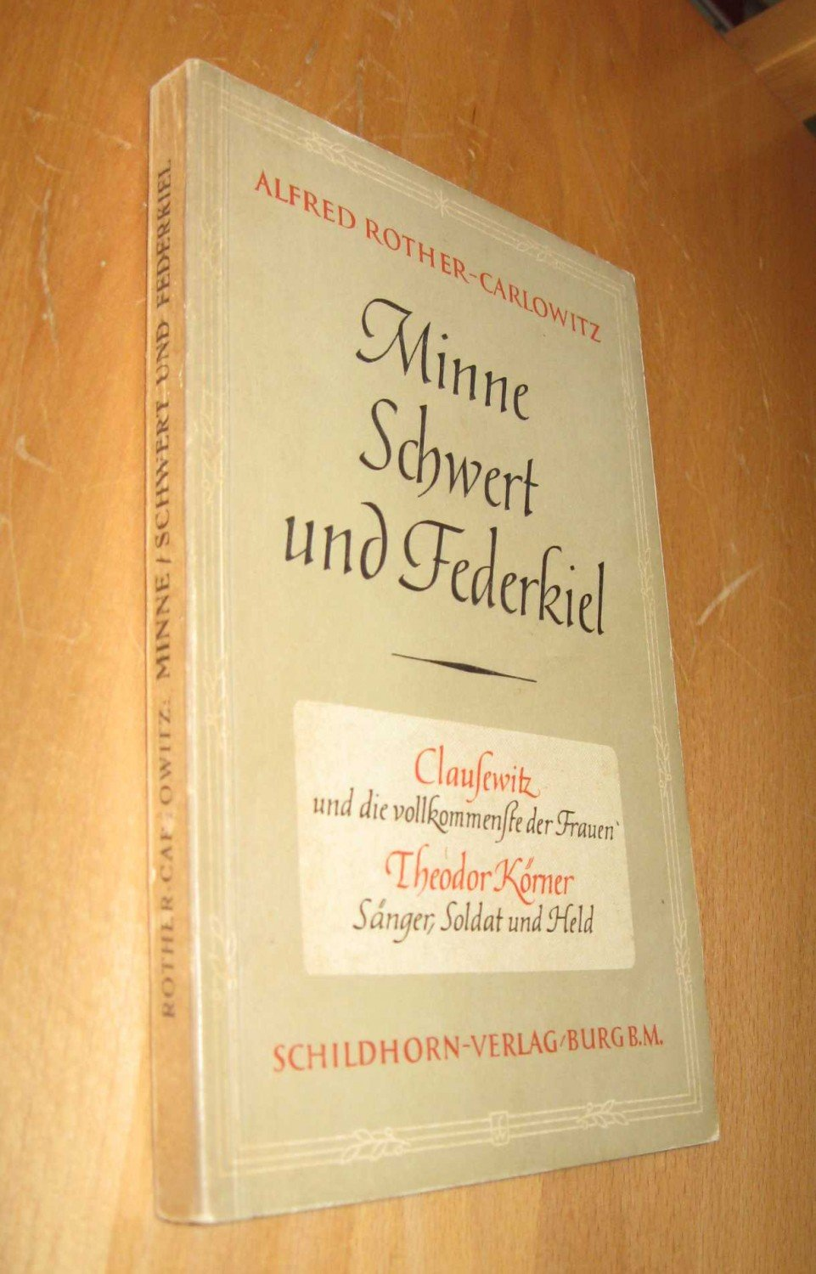
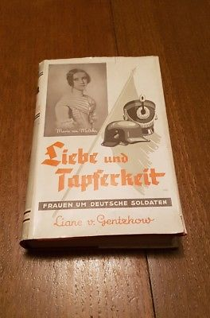
And the Nazis loved Marie von Clausewitz too

Slide 18
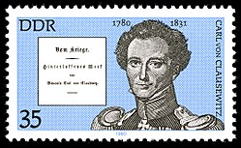
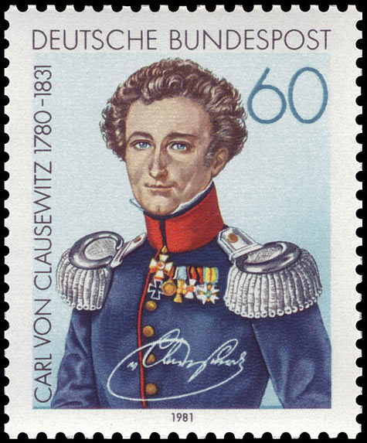
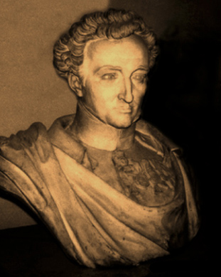
Buste des Generals Clausewitz im Zeughaus zu Berlin. Deutsches Historisches Museum

Slide 19
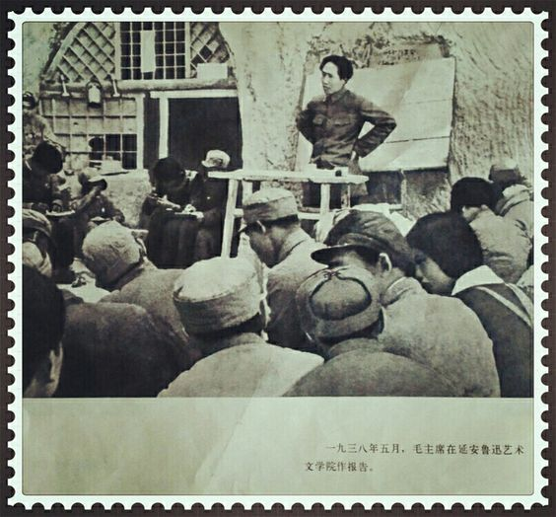
By early 1900s he was translated into English, French, Japanese and Russian → Lenin reads him
Chinese translation is made on basis of Japanese translation
Mao Zedong read him and took part in weekly Clausewitz study group after Long Mach at the Yan’an base area in 1938 -> Mao cites him in On Protracted War (1938)

Slide 20
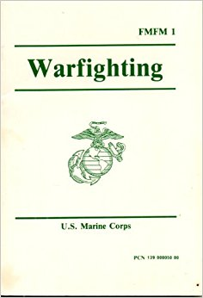
It was Vietnamese Tet offensive of 1968 that led the US army to start reading Clausewitz
The US naval war college was the first to make Clausewitz reading mandatory in 1976, followed by the Air War College in 1978 and West Point in 1981.
Marine Corps doctrinal manual of 1989 is Clausewitz paraphrased.

Slide 21
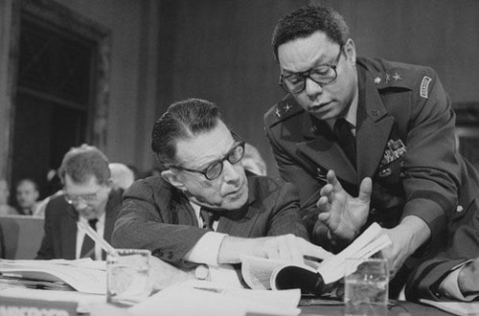
Colin Powell is an avid student of Clausewitz and influences Defense Secretary Caspar Weinberger

Slide 22
Crimson Tide 1995 – The True Enemy is War Itself – Krieg “an sich”

Slide 23
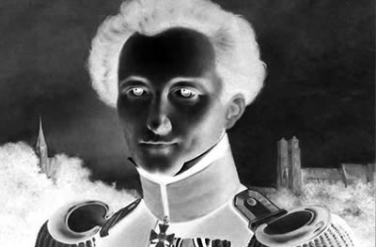
Four Clausewitzes:
The historical Clausewitz
The Clausewitz of the ahistorical sound bite, management wisdom
Clausewitz the situated analyst of Napoleonic warfare
Clausewitz after 1827: the meta-theoretician of war

Slide 24
Born 1780 to family of pastors and theologians. His father was unusual case of a commoner who made it to officer rank in army of Frederick the Great.
Young Clausewitz served from age of 12 in revolutionary war
1801 studied with Scharnhorst at the Kriegsakademie
1806 captured by French at Jena
In 1809 he was tempted to go over to he Austrians when they stood up to Napoleon. As he wrote to his beloved: He viewed with disdain “such people, who bear continuously the word Prussia on their lips so the word German does not remind them of the heavy, sacred duties”.
Dec 1810 married Marie von Brühl. They were a society couple with well known radical political views. In fact Clausewitz’s connections to Scharnhorst were what made his mother in law accept him. But made him suspect at court.

Slide 25
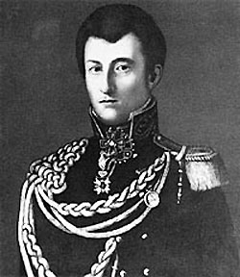
1812 spring defects to Russian side
He and his wife expect it to be a long-term commitment → she considers moving to Russia.
Clausewitz volunteers for the rearguard in retreat to Moscow → combat with French on almost daily basis
Resisting French advance to Moscow he wins decoration for bravery at Borodino the single bloodiest day of Napoleonic war with 65,000 casualties.
Takes part in scorched earth operation burning hundreds of villages ahead of advancing French.

Slide 26
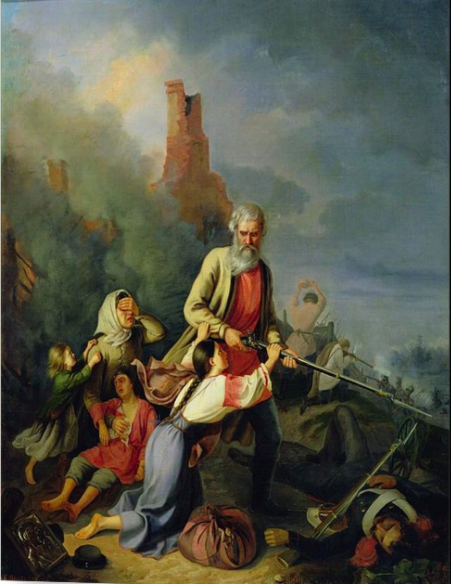
Tsar Alexander → declares peoples war.
Peasants are called on to rise up against French.
Cossacks harry their rear as their own cavalry decline.
Russian peasants rise up against French (painting 1855)

Slide 27
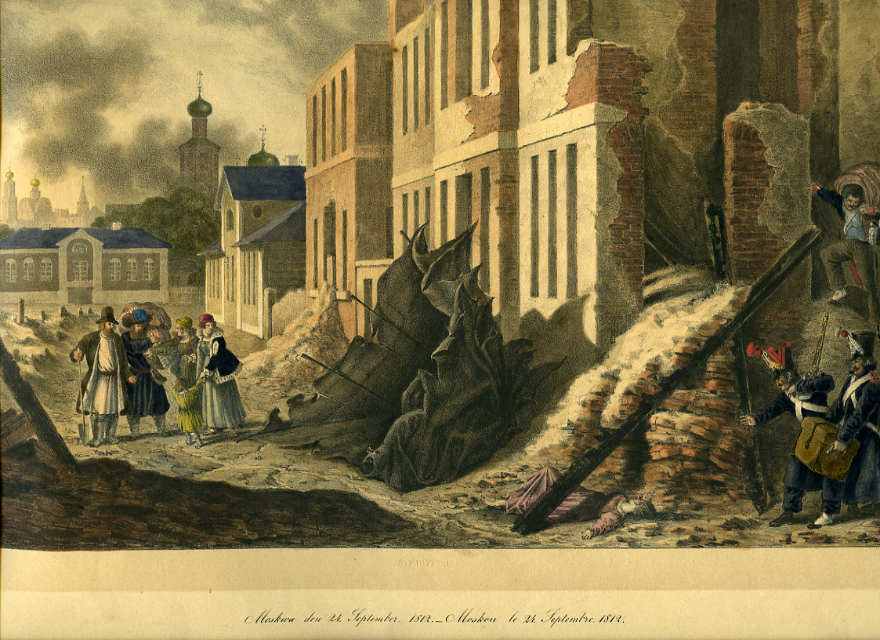
Clausewitz witnessed the burning of Moscow along with thousands of wounded Russian soldiers
Christian Wilhelm von Faber du Faur (1780-1857), Russian citizens between rubble and soldiers from the 3rd French army corps during the looting in Moscow on September 24, 1812
Image Credit: © DHM, Berlin, Germany

Slide 28
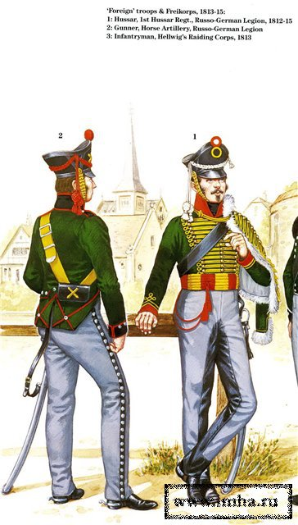
His best friend, another Prussian defector, was killed by Prussian cavalry in August 1812
Prussian king undertakes legal proceedings against him to strip him of his assets.
Joins the Russo-German legion in St Petersburg with other German exiles (Prussian and Saxon) with German nationalist Ernst Moritz Arndt as their chief propagandist
St Petersburg never occupied by the French. Defended by Russian general von Wittgenstein aged 40 whose chief advisor General Diebitsch was a 27 year old brilliant German ex-pat
This was the force that cut the French off at the Berezina

Slide 29
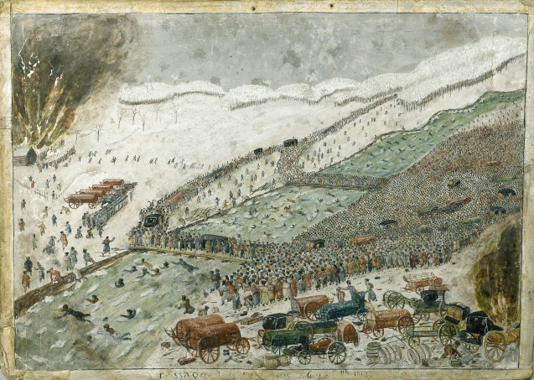
Clausewitz’s description: “… If my feelings had not already been hardened … I would not get a hold of myself for shuddering and disgust, and still after many years I will not be able to think about it without shuddering … I am writing you between corpses and the dying, among the smoking ruins, and thousands of ghost-like people file past and shout, and stand, and cry in vain for bread.” Clausewitz to Marie 27-28 November 1812

Slide 30
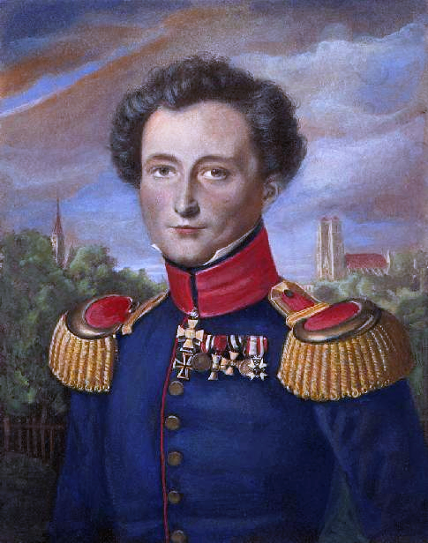
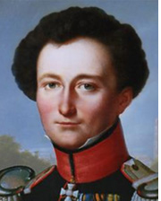
Clausewitz himself suffers permanent frostbite damage to the face that leads people to accuse him of being an alcoholic.

Slide 31
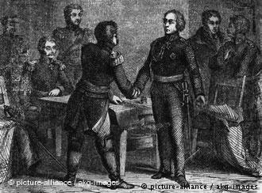
On 23 December the screening force of which Clausewitz is part encounters what at first they thought was Prussian rearguard → Clausewitz terrified he will end up fighting two of his brothers who are fighting in Prussian corps.
It turns out that it was the main Prussian force headed by York with 14,000 men
Clausewitz’s force needed to trick them into surrendering or switching sides or be crushed.
Yorck is deeply hesitant: “It’s easy for you to talk, you young people, but this old man’s head is shaking on his shoulders.”
Finally on night of 30 December 1812 he is won over – Clausewitz is part of core team that orchestrates East Prussian uprising in 1813. Against Napoleon. Against the Prussian king.

Slide 32
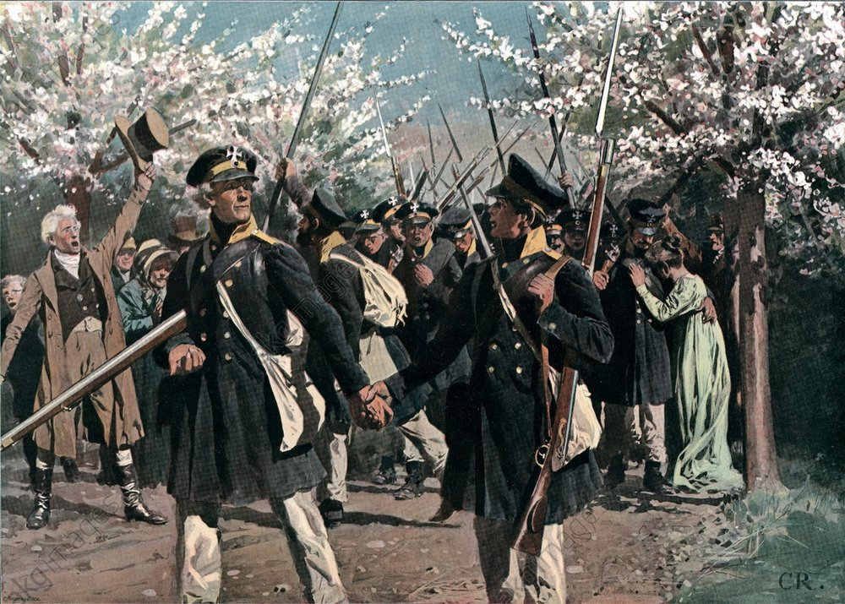
The glory days:
“Being with a very dear little army, which is headed by my friends, passing through beautiful country during the nice time of the year, for such a purpose (i.e. driving out the French), is pretty much the ideal of Earthly existence (that is if you think of this life as transient and leading to other existences). My friend Gneisenau looks like a god in his general’s uniform. The troops are happy and sing “Auf, auf Kameraden!” and similar songs, others yodel to perfection. I see myself surrounded by friends and living again in the environment of my mother tongue. I even see my students again, I’ve never had so much fun as under these circumstances.” April 1 1813 Clausewitz to Marie as the Prussian army marched through Saxony
“Auf, auf Kameraden” is a song composed by Schiller to accompany his drama about Wallenstein A hit of 1797

Slide 33
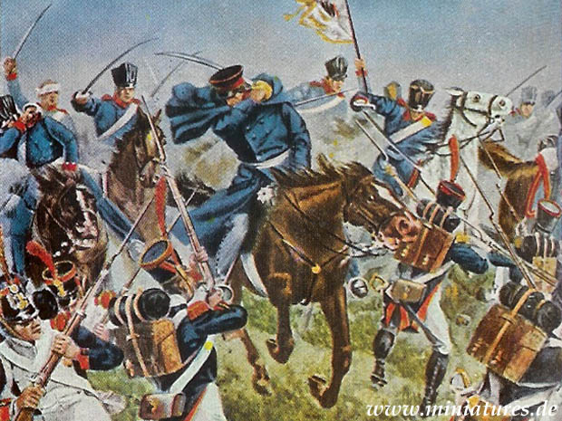
May 2 1813 battle of Grossgörschen aka the second battle of Lützen on the same battlefield where Gustavus Adolphus died, Clausewitz was almost killed in a cavalry charge
Stabbed in head by French bayonet, fighting alongside Gneisenau, Bluecher and Scharnhorst
He was denied an iron cross because he was serving in the Russian army.

Slide 34
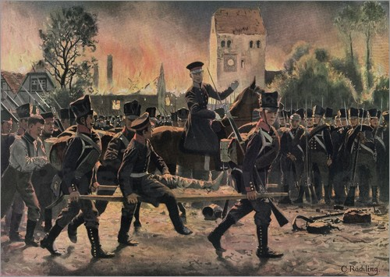
Weeks later his hero, Scharnhorst, died of the wounds he received. The obituaries written by Clausewitz and Gneisenau are censored because they celebrate the rally in East Prussia against the hesitancy of the Prussian king.

Slide 35
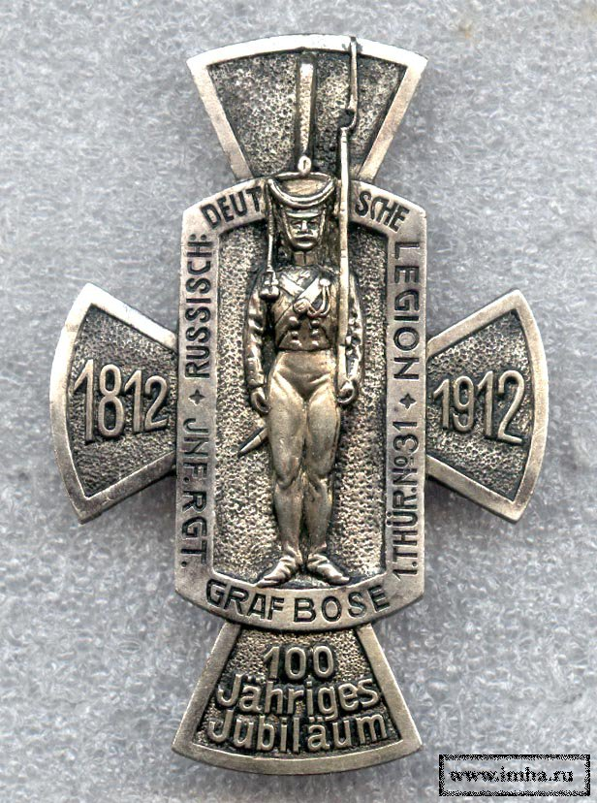
Clausewitz is in the wrong army!
Princess Charlotte writes at the same time. I have read Arndt’s pamphlet on the Russo-German legion in which “fighting against one’s own fatherland is potrayed as the greatest virtue and Tiedemann, Clausewitz and company are presented as the greatest men of honor … this. I confess, has disgusted me to my core.” → Clausewitz told by king that he would be readmitted to Prussian army only once he had distinguished himself personally in battle fighting as a Russian.
Denied a commission in the Prussian army until 1814 →
Misses out on Leipzig

Slide 36
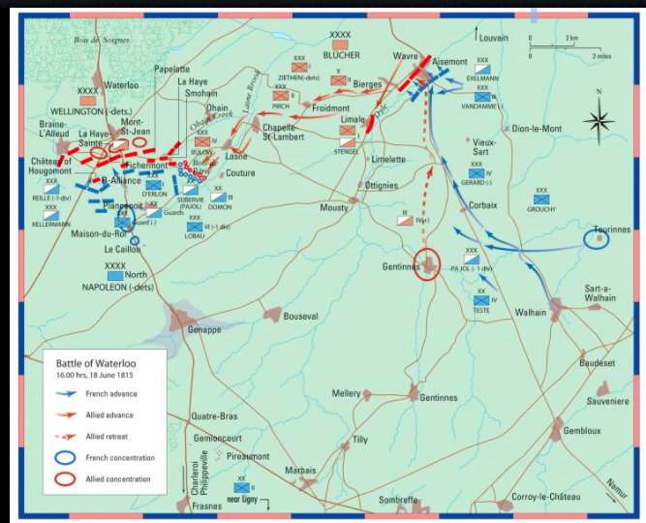
Whilst Wellington and Blücher’ Prussian troops triumph at Waterloo, on 18 June 1815 Clausewtiz manages to be chief of staff in the last battle the Allies lose to the french i.e. the desperate holding action at Wavre to the East of the main action

Slide 37
Tide turns against the reformers:
1816 July Gneisenau temporarily retires from the army
Clausewitz and the wartime generation of reformers are fighting to protect the Landwehr
1818 Clausewitz named Director of the Kriegsakademie
1819 Von Boyen dismissed as Minister of war = last of the great reform generation removed from office. → Landwehr brought under army control.
Clausewitz is blocked from further promotion on account of his and his wife’s association with radical reform movement
1816 Clausewitz starts writing On War
Wrote a study of Scharnhorst
Copius technical notes
Studies of 1812 and 1815 campaign
Frederick the Great’s campaigns and wars of 1890s
Temporarily halts work on On War in the spring of 1830

Slide 38
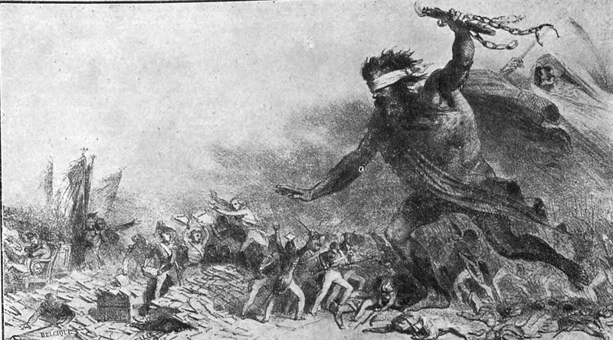
1830 Gneisenau and Clausewitz both mobilized to deal with a double threat on Prussia’s eastern border: Polish revolution, Russian military intervention and a new plague
1831: "La Barbarie et Le Choléra-Morbus Entrant en Europe. Les Polonais se battent, les puissances font des protocoles et la France...” Denis-Auguste-Marie Raffet

Slide 39
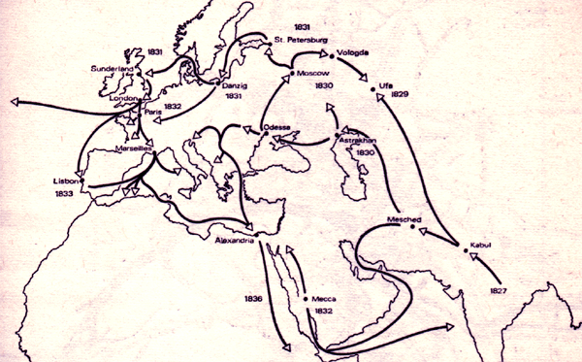
The Second Global Cholera Pandemic 1827-1831
24 August 1831 Gneisenau dies
Clausewitz gave his last lecture on 16 November 1831 fell ill with cholera and died that same day.
Hegel dies in December 1831

Slide 40
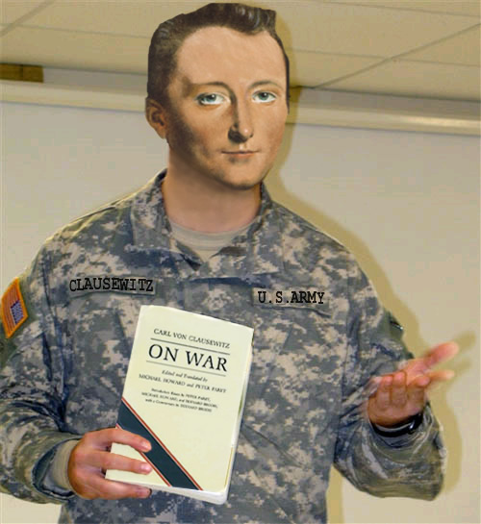
His remarkable biography gets Clausewitz into War and Peace in 1869 but how does he end up as a Jack Welch sound bite?
From Jack Welch (GE): "Von Clausewitz summed up what it had all been about in his classic On War. Men could not reduce strategy to a formula. Detailed planning necessarily failed, due to the inevitable frictions encountered: chance events, imperfections in execution, and the independent will of the opposition. Instead, the human elements were paramount: leadership, morale, and the almost instinctive savvy of the best generals. The Prussian general staff, under the elder von Moltke, perfected these concepts in practice.

Slide 41
Clausewitz II - Sound Bite Clausewitz
Defence is the stronger form of warfare, but defence must always go over to the attack.
Great successes determine the smaller ones … not the other way around.
Strategic effects therefore arise from particular moments and centers of gravity.
A demonstration is a weaker use of force than a real attack and must therefore be limited to very particular conditions.
Victory is not merely the conquest of the battlefield but the destruction of the physical and moral fighting force of the enemy. It is the follow up of the battle that is decisive in achieving this.
The greatest successes are achieved where the fighting is most intense.
Redirecting the focus of attack is at best a necessary evil.
Given the risks involved an attempt to attack from the rear can be justified only on the basis of substantial superiority or by superior lines of communications and better lines of retreat.
Flanking attempts are subject to the same constraint.
Every attack weakens as it progresses.

Slide 42
1. Clausewitz did sound bites: He was throughout his life preoccupied with practical education. Clausewitz’s students wanted lists of maxims drawn up in a formulaic style and he supplied them.
2. The lists of points, like the one above, do convey a flavor of his thought. It is about focus and force. It is about not flinching from combat. It is about taking on the biggest challenge and throwing your full weight at it. It’s a tough minded, virile doctrine of strength.
3. War is urgent, confusing, high stakes, terrifying → there are situations in which it is important NOT TO OVERTHINK → soundbites may be trite but they are fit for purpose.

Slide 43
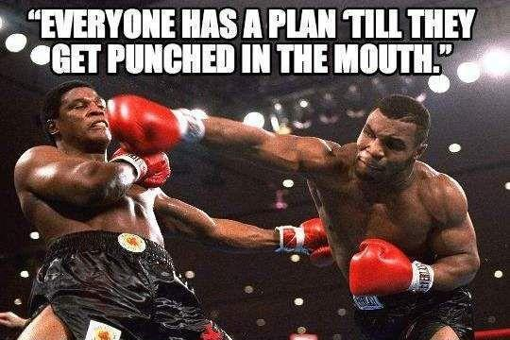
→ Sound bites in their own way actually capture an authentic Clausewitz, though this may not be the most interesting version.

Slide 44
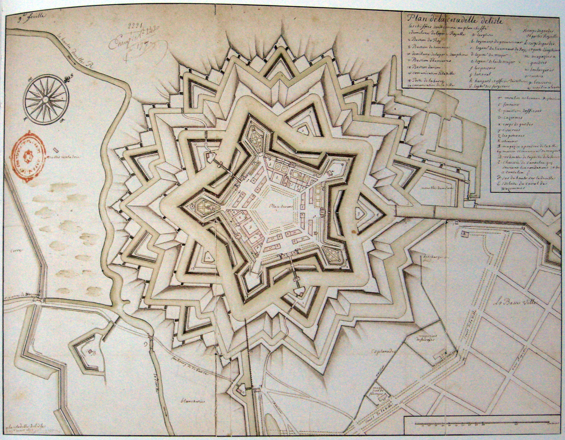
Clausewitz III: The irony of reducing Clausewitz to formulae is that his central intellectual mission was to demolish the overly rationalist vision of war as something reducible to formulae.

Slide 45
In the 1790s the search for peace by means of negotiation and schemes à la Kant had had disastrous consequences:
Prussia’s peace policy of the 1790s and early 1800s fails → Napoleon pushed forward relentlessly to battle and achieved decision at Austerlitz (1805) Jena and Auerstedt (1806):
“The main battle is the most natural means of achieving, a big, positive … purpose … normally one is punished if one tries to avoid it for fear of the great decision …. The main battle is the bloodiest solution … blood is always its price and slaughter its character, from which the humanely [minded] military commander-in-chief flinches …” But: “We do not hear about commanders-in-chief who win without shedding human blood. If bloody battles are a horrible spectacle, this must only lead us to respect war all the more, not, however, to allow swords to be blunted by humanitarian qualms, until there is once again a sharp sword amongst us which will hack off our arms at our shoulders.” (Book IV 4 427ff)

Slide 46
Napoleonic history reveals absolute war – a central philosophical and abstract point is revealed in time:
“The whole people threw its weight into the scales. …the means that could be used, the effort that could be made, no longer knew limits; the energy with which the war itself could be waged was no longer checked, and consequently the danger for the adversary was extreme. In Bonaparte’s hand all this was brought to perfection, and this force of war, based on the entire strength of the people, wrought havoc upon Europe…”

Slide 47
Escalation – “each” combatant “gives the other the law, as so both escalate to the most extreme limit…”.
Battle of Leipzig, 3 days 600,000 men (Vladimir Moshkov, 1815)

Slide 48
Keys to victory were as much psychological as strictly intellectual
Act on the enemy’s will – “Fear cripples the intellect, courage inspires it”.
Act in the face of the fog of war - “The great uncertainty of all data in war is a peculiar difficulty, because all action must, to a certain extent, be planned in a mere twilight, which in addition not infrequently — like the effect of a fog or moonlight — gives to things exaggerated dimensions and unnatural appearance.”

Slide 49
Leadership is key, but what does it consist of?
Courage – old fashioned hero
Insights into nature – enlightenment rationalist view
3. Calmness amidst fog of war
4. Creativity & art
= characteristic synthesis of the transition period from enlightenment to romanticism.

Slide 50
Creativity is understood as dialectically interrelated with the law.
On instruction of Marie whilst he was detained as privileged POW in Paris, Clausewitz studied art and Kant’s aesthetic theory.
Artistic creativity is the attainment of a certain aim through the creative ability of combining given means.
Artistic genius breaks patterns and makes new ones, breaks and makes new laws: “the talent that gives the rule to art” the “talent for producing that for which no definite rule can be given” which rather formed the basis for new rules.
Clausewitz derives from this the idea of military knowledge not as strict quantitative science, or geometry, not knowledge, but koennen (ability, skill) and Kunst (art).
Strategy, the creative combination of battles, was such an Art and he insisted that it could never be a rule bound scientific discipline, but “must always remain in the sphere of free (unsystematic) reasoning.”

Slide 51
Policy and war are related not just substantively but formally
Policy, war, art have in common that they achieve effects by working with given materials to create something new → war as the extension of policy by other means.
And how could this craft be trained? The answer that Clausewitz gave was: through the study of modern history. What future commanders needed to immerse themselves in was history.
Not law-like mechanical expositions of pre-formulated theories.
Not out of date, poorly sourced Roman or Greek history.
But live action, flesh and blood narrative accounts of the confusing, visceral violent reality of modern war since 1648.

Slide 52
Clausewitz had freed himself from the abstractions of 18th century military natural philosophy. Napoleon’s violent intervention had exposed those views of the world as the time-bound artifacts that they were. But in distilling that experience into his own general conceptualization of war, had Clausewitz succumbed to the same problem that he had criticized in his predecessors? Had he in fact turned the type of warfare specific to his generation i.e. massive, decisive, all or nothing Napoleonic war into his own timeless abstraction?

Slide 53
Clausewitz’s epiphany from the letter to General Roeder December 1827

Slide 54
Clausewitz IV – to grasp war in general we need to situate the Thirty Years War, the Seven Years War and the Napoleonic War in a more general frame

Slide 55
Back to geometry! The Trinitarian View of War, Clausewitz, On War Book I, Chapter 1

Slide 56
“War is the extension of policy by other means” → Clausewitz is actually arguing for “civilian” government control!
The liberal reading of Clausewitz reinforced by a shocking philological discovery:
Clausewitz on civilian-military relations 1831 original: “highest military commander” should be a member “of the Cabinet, so that it can participate in the main moments of his actions.”
The falsified second edition 1853: “highest military commander” should be “a member of the Cabinet, so that he can participate in its most important deliberations and decisions.”

Slide 57
Remember 1812-3
Fuelled by passion Clausewitz and his fellow officers had rebelled against reason of state as articulated by Prussian monarchy! “I can no longer carry the flag which I have devotedly followed with my life for twenty years.” He wrote again to Marie on 26th April 1812: “The misfortune of the Fatherland has reached its summit, for her princes are slaves who take up swords against themselves at their master's (Napoleon’s) command.”

