Slide 1
War in Germany 2018 Lecture 1
Adam Tooze
Columbia
January 2018

Slide 2
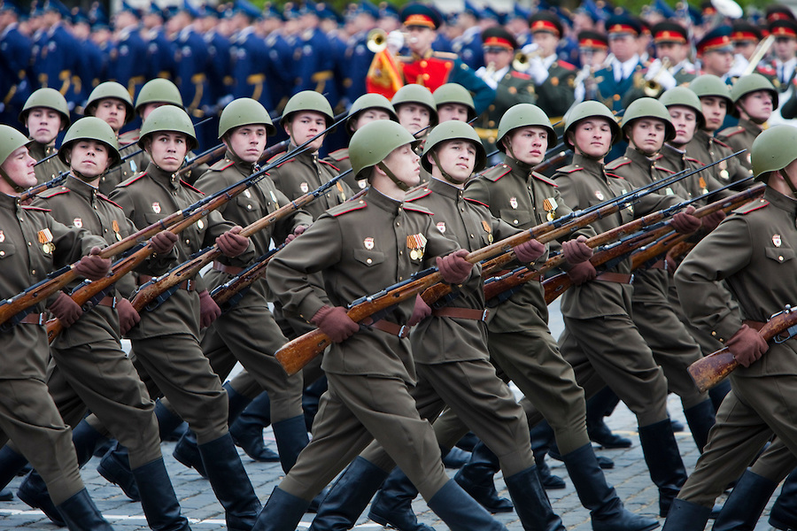
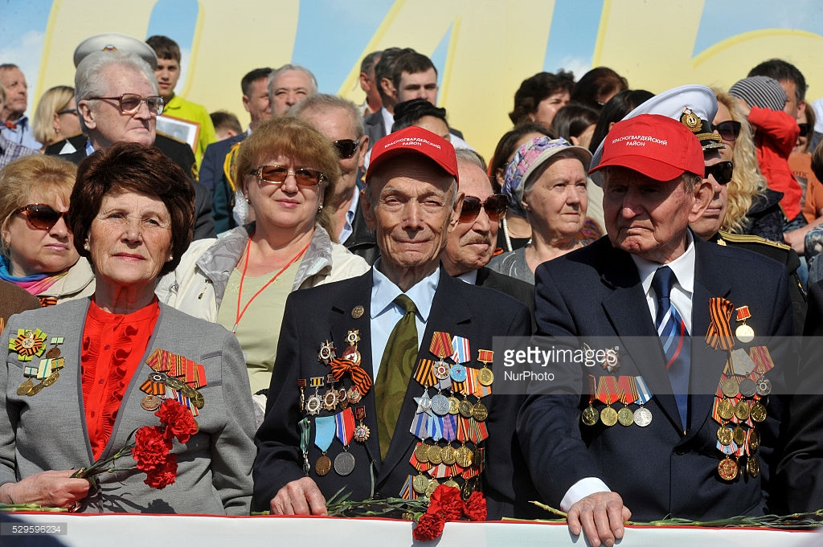
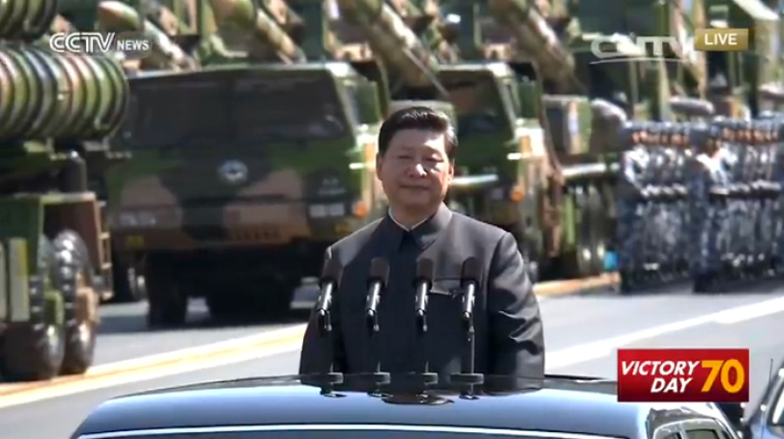
The wars of the 20th century are still with us to a remarkable extent.

Slide 3
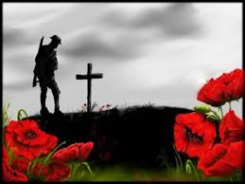
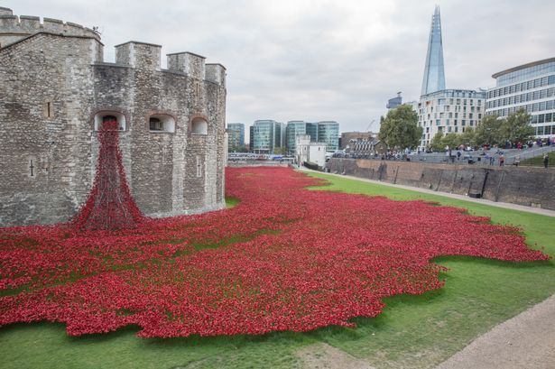

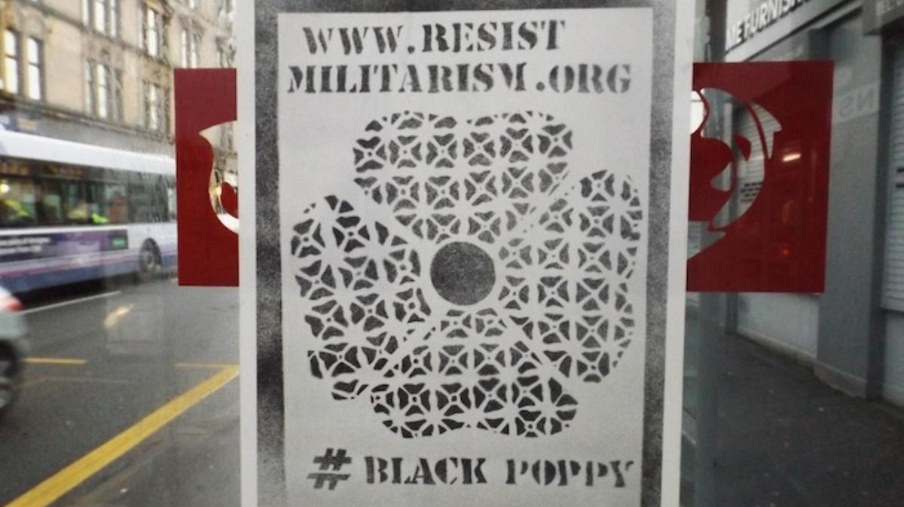

Slide 4
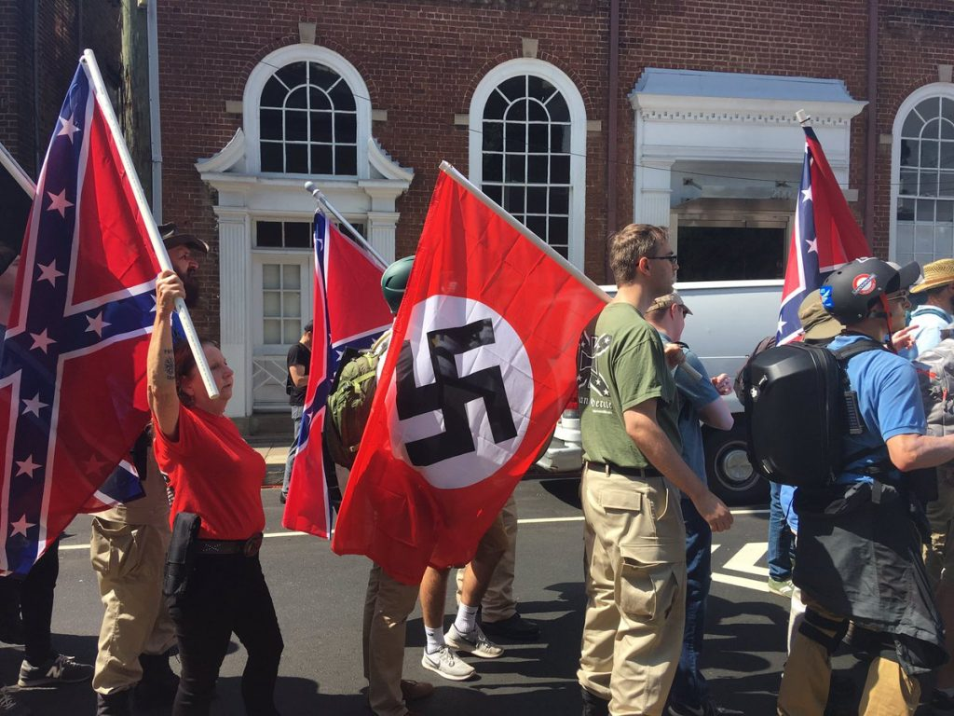
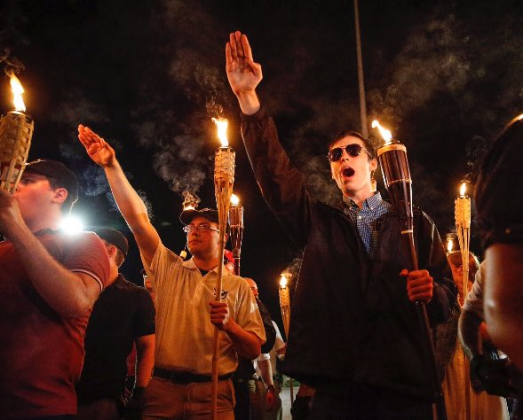
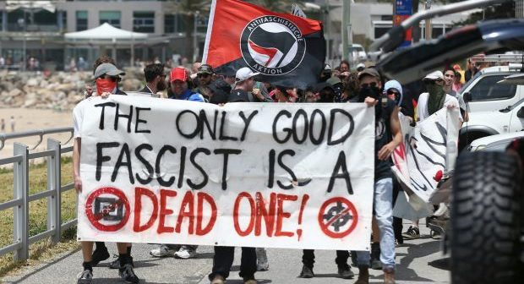
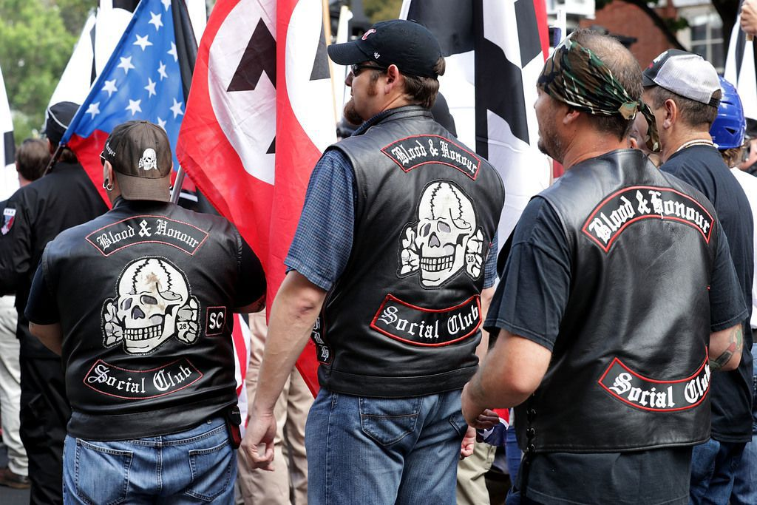

Slide 5
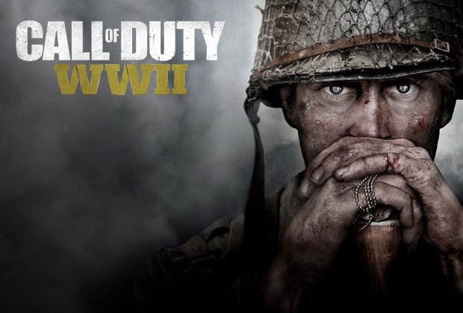
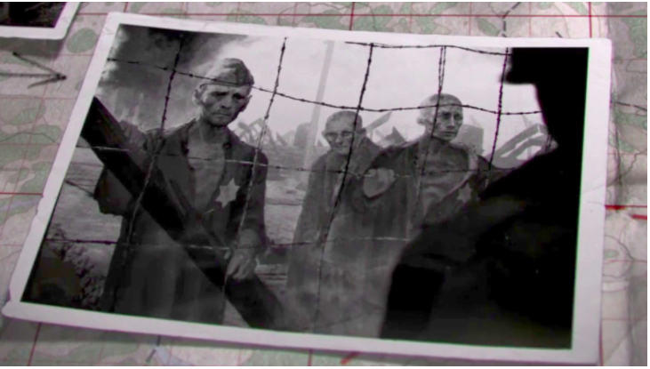
Playing World War II in your living room. In November 2017.
Now with added Holocaust

Slide 6
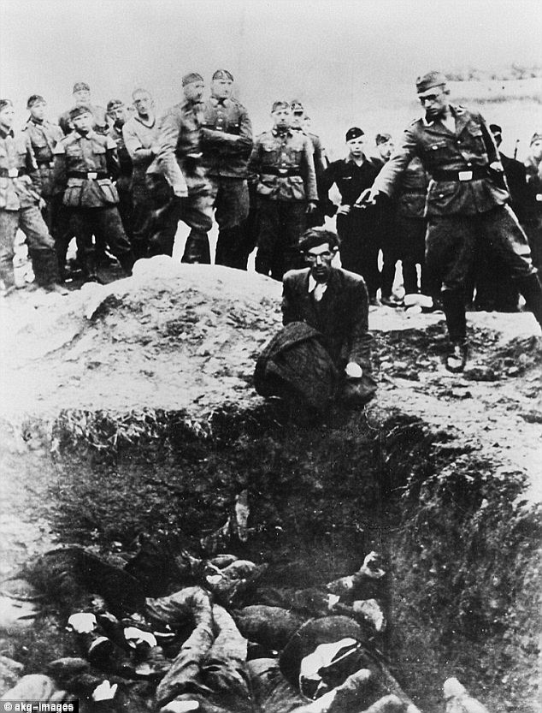
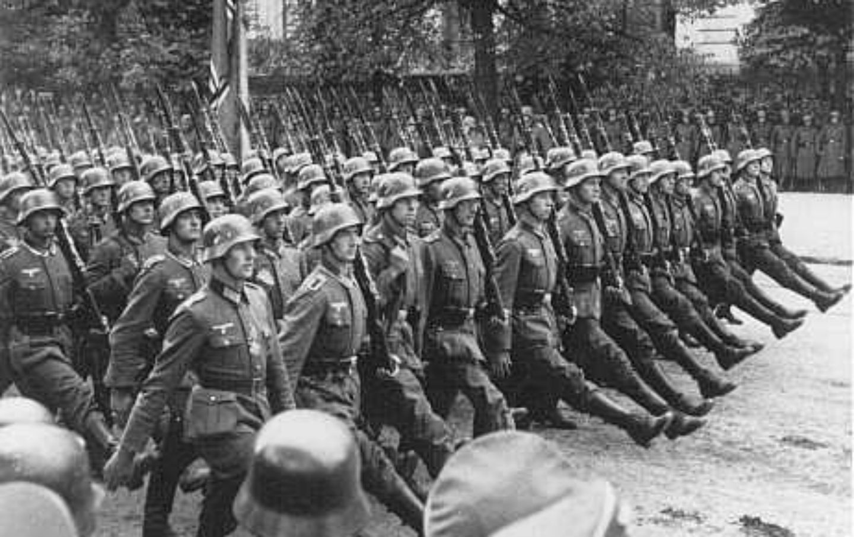
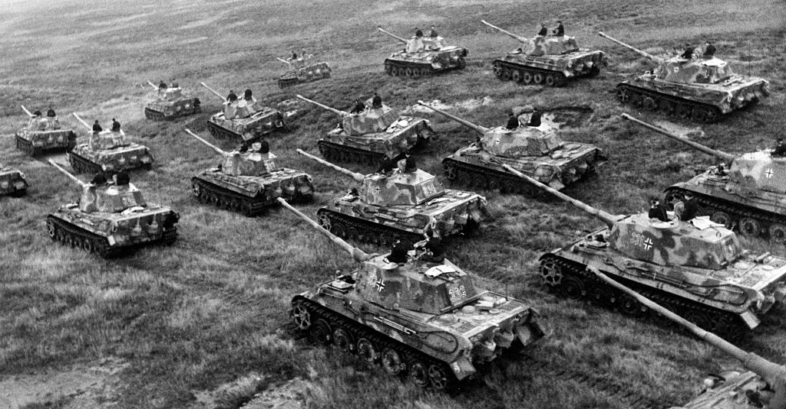
Country that is the common denominator is Germany
The inescapable challenge of this course: how to understand how Germany arrived at this point.

Slide 7

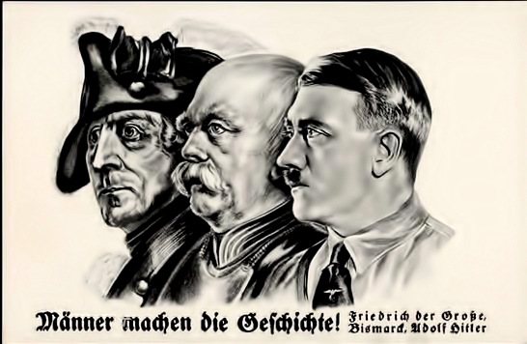
There is a long tradition of asking and answering this question:
You can construct stories of deep continuity. Indeed, the Nazis do it themselves.
But this should surely make us suspicious of such Sonderweg stories.

Slide 8
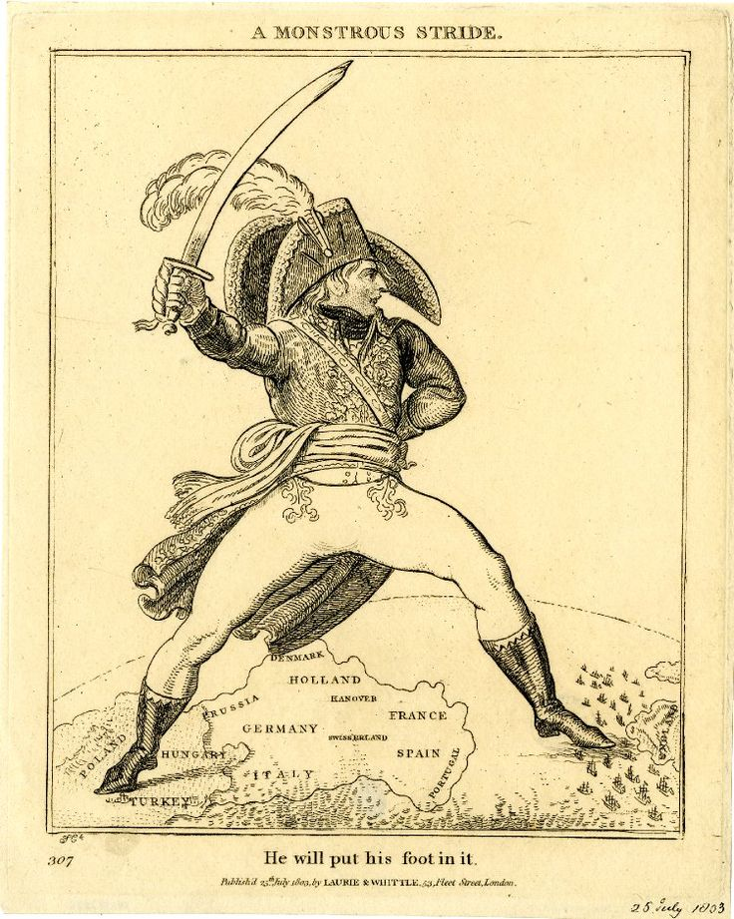
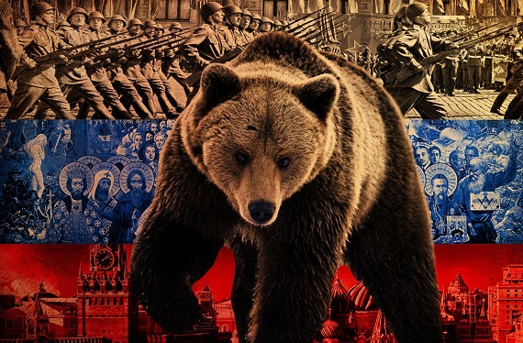
If you asked a British person to name a European country that might seek to dominate the continent by military means, until the late nineteenth century the obvious answer would be?
France
.. Or Russia

Slide 9
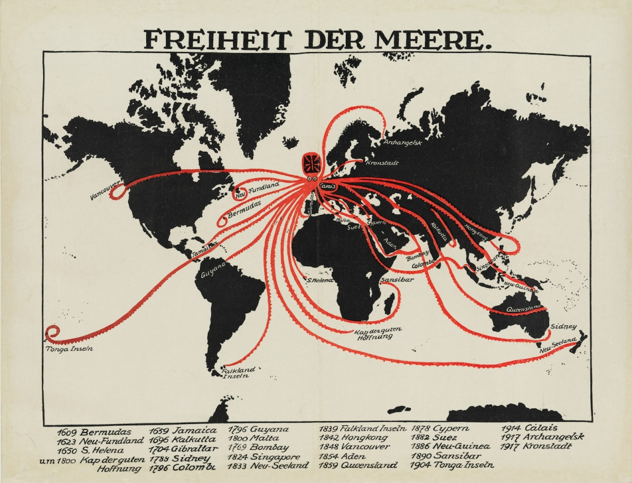
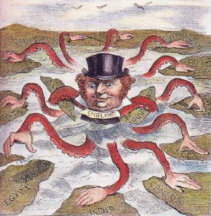
If you told a French person that a country was seeking to dominate not just Europe but the world. The only plausible answer would be …
The British Empire.
Germans would agree

Slide 10
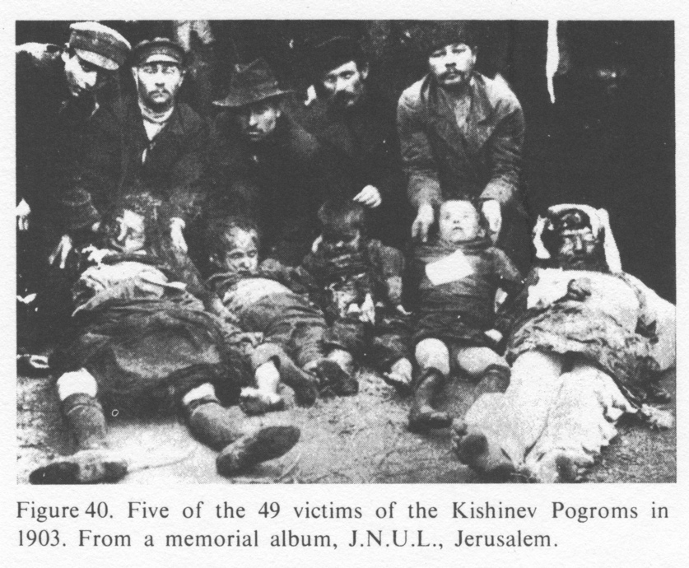
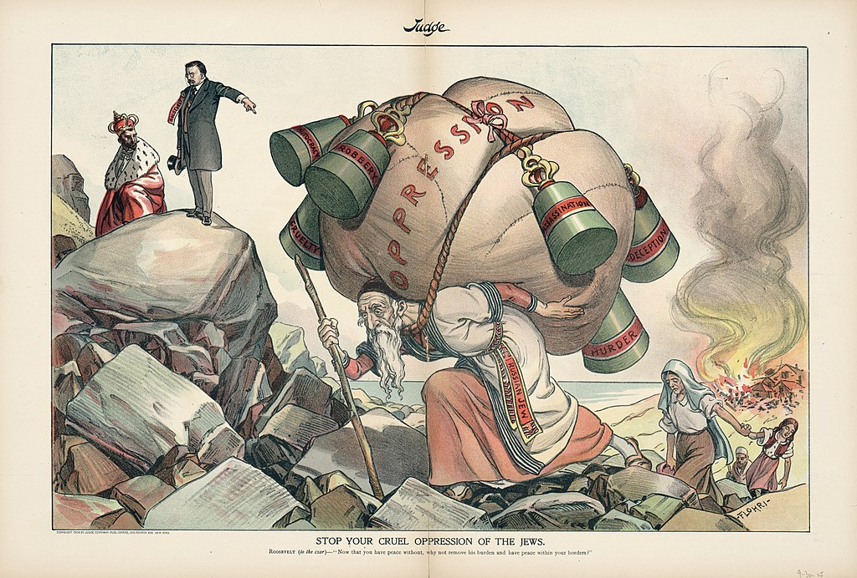
If you told someone in 1900 there would be a terrible genocide against Europe’s Jews. The obvious response would be …?
Russia!

Slide 11
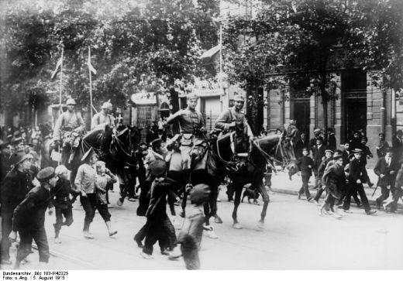
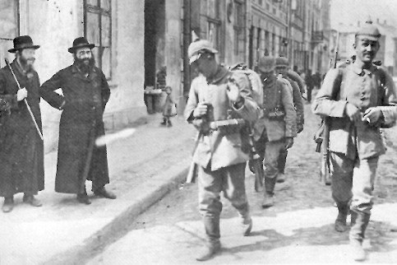
The first time the Germans invaded Poland in the twentieth century – in August 1915 - the Poles were actually pleased to see them.

Slide 12
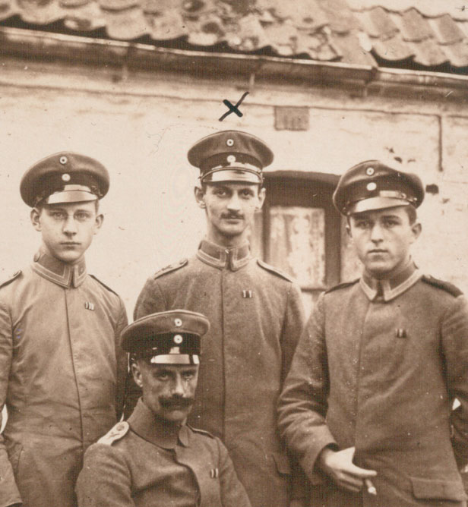
Lieutenant Otto Frank, father of Anne Frank, serving enthusiastically in Imperial German Army July 1917

Slide 13
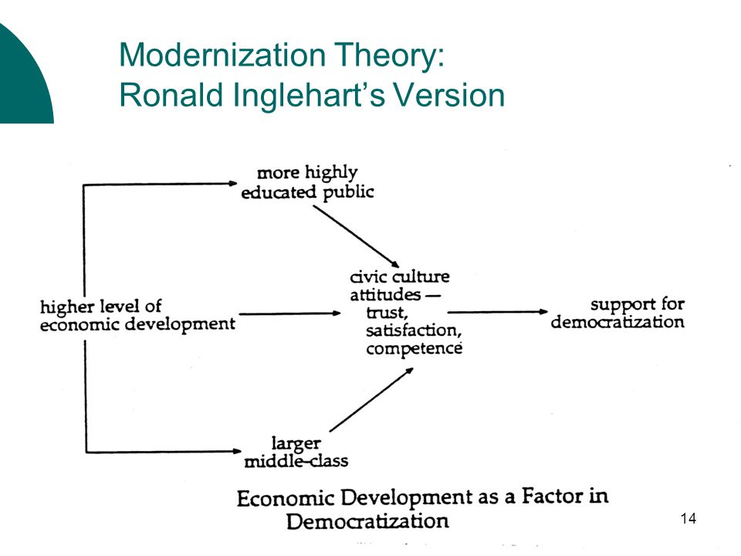
We need stories not of how Germany was always bad, but how it went wrong.
But that requires us to have some kind of model of how societies and polities evolve.
Then you can specify the bits that failed to develop properly in Germany.
Problem 1: You have to agree on a model of “proper”, “normal” development that will ensure you don’t end up where Germany ended up.

Slide 14
Problem 2: Defining what is normal and what is not is obviously a highly political business. History and social theory tends to be written by those who win → It’s a nasty circularity – the theories and views of history with which we are going to explain why Germany started wars, engaged in genocide etc will be shaped by those who won those wars, crushed, defeated and condemned Germany.
NB: I am NOT saying that we would be able to see the truth about World War II more clearly, if Nazi Germany had not been defeated!
(Though think about World War I and you can see where that thought might lead.)
But I am saying that we have to beware the way our victors history shapes our understanding.

Slide 15
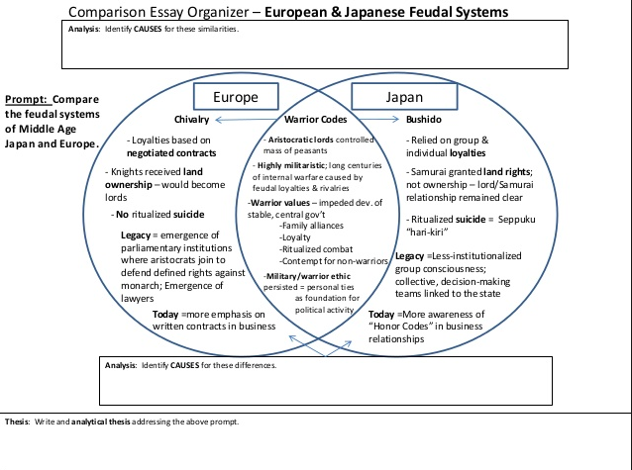
Problem 3: Theories of modernization commonly attribute warlike attributes to the legacies of feudalism
→ They suggest the question: Can you escape war by overcoming the past?

Slide 16
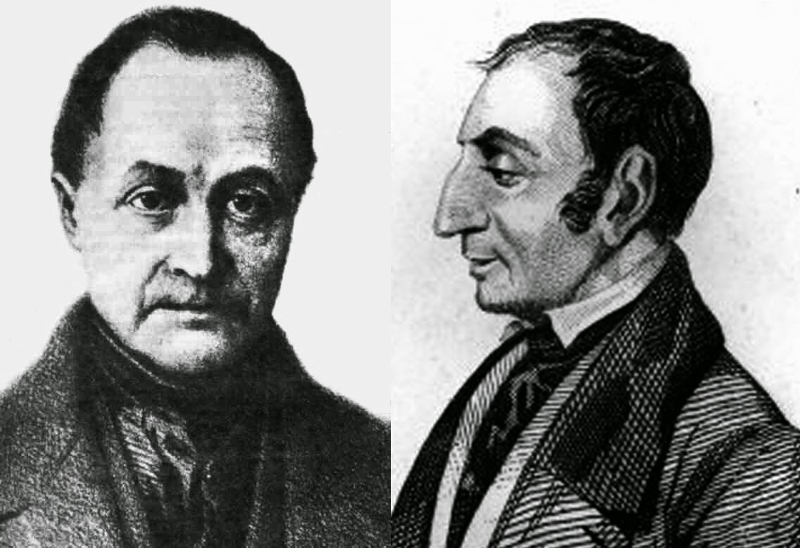
Already in early 19th century in wake of wars of religion (1500 and 1600s), dynastic absolutism (1600s and 1700s) and French revolution and Napoleonic era 1792-1815, early social scientists were pronouncing war and military culture as historically obsolete.
Saint-Simon promised that industry would replace aristocratic violence.
August Comte specified three stages: “Human activity, as I have long since shown, passes successively through the stages of Offensive warfare, Defensive warfare, and Industry.”
Comte’s mid Victorian popularizers (Martineau) formulated it as axiomatic that there was a “change, natural and universal as it is” , towards “the anti-military character of modern society, to which war is more and more an exceptional state …”.

Slide 17
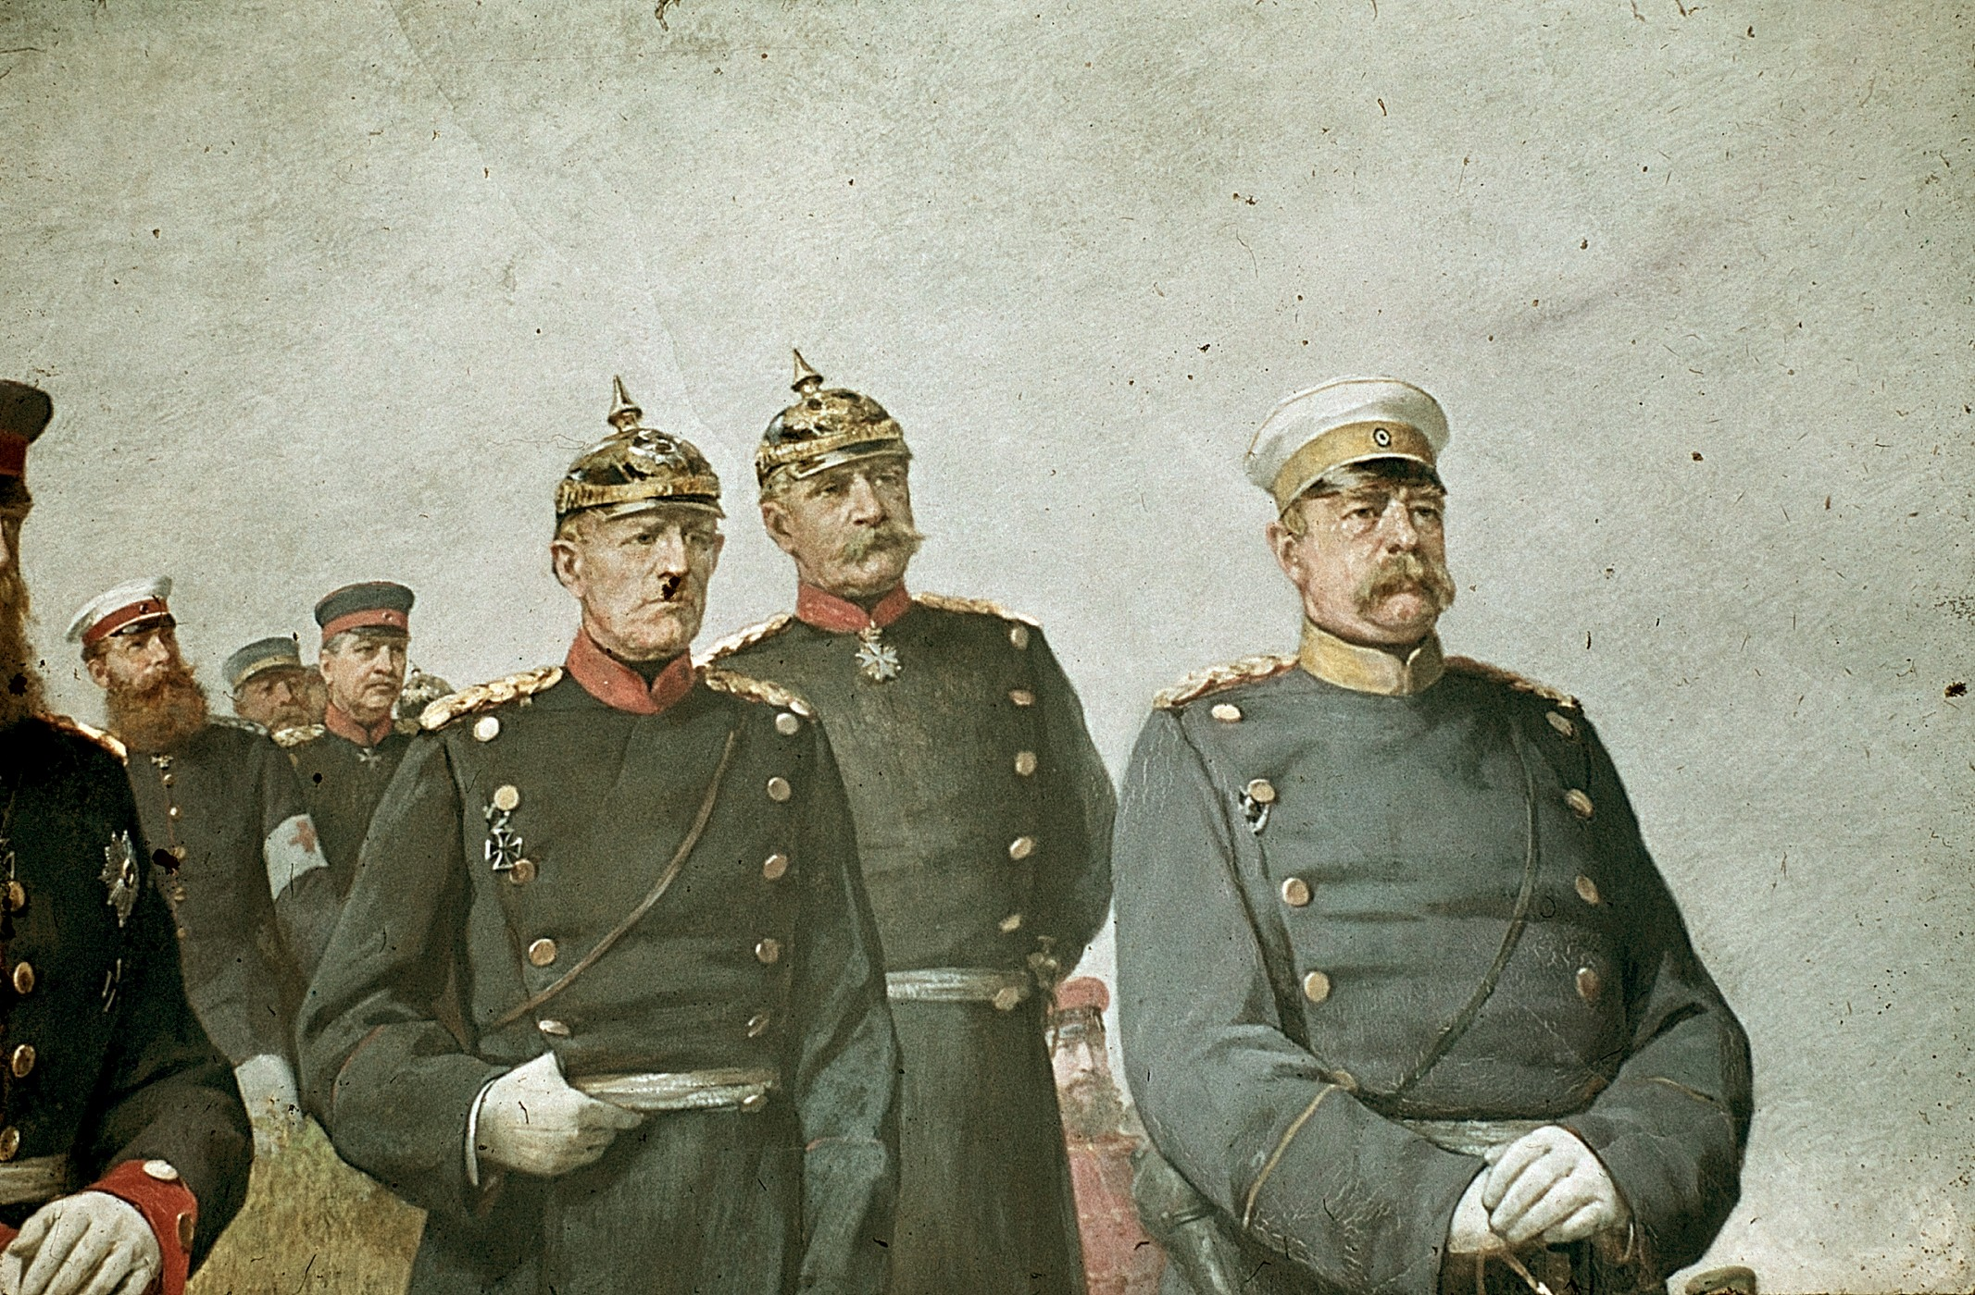
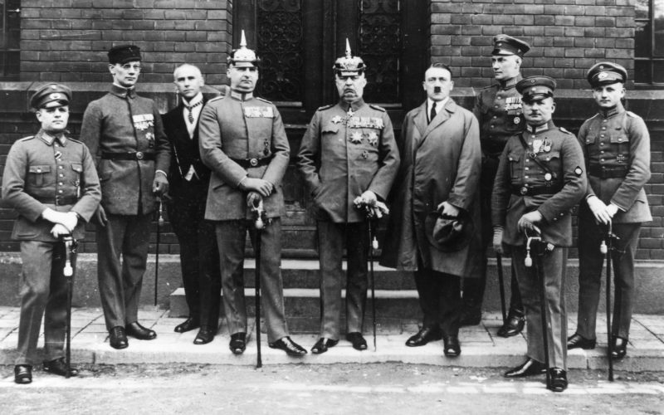
So is the real line of continuity here not Germanness but a failure to modernize?

Slide 18
But can a theory of retarded modernization account for this list of wars between 1900 and 1945?
It is true that conflicts flare around the periphery.
But the powers involved are not themselves particularly backward and include many of those who fancied themselves more modern than the Germans e.g. French, Brits, Americans
One might be tempted to say that the significance of WWI and WWII is that in those conflicts violence fluxed back from periphery to heart of world power in Europe.
Boxer intervention
Boer war
Philippine insurrection
Herero uprising
Russo-Japanese war
Italian-Turkish war in Libya
Balkan war
WWI
Russian intervention, civil war, Polish-Soviet war
Turkish independence wars
Afghan wars
Chinese warlord wars, Northern expedition and western interventions
Spanish in Rif war
French intervention in Syria
Italian Libyan expedition
Spanish civil war
Chinese Japanese wars
Russo-Finish war
WWII

Slide 19
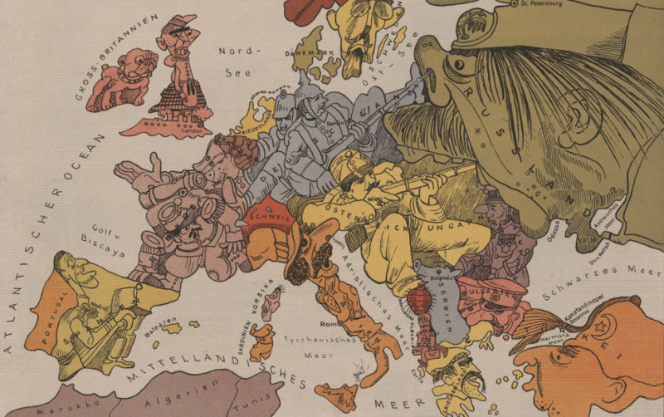
So unfair does it seem to describe the likes of Germany as peculiarly warlike that many are tempted to go completely in the opposite direction.
This is most manifest in the profound differences that still remain over who or what started World War I – was it down to one rogue state, a group of rogue states, or a systemic crisis?
Realist international relations theory codifies the latter view.

Slide 20
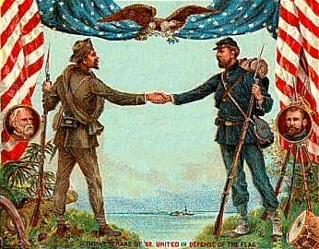
Thinking about soldiers rather than states we face a similar tension:
Soldiers themselves and those who admire them are torn between two different views.
1. One is that soldiers are warriors for their side.
2. The other is that they are professionals who have specific skills and attributes that cross borders.
On top of this, the heat of warlike emotion and intensity of combat cannot last forever and soon gives way to exhaustion and a desire for reconciliation.
The result is the kind of history of the American civil war that erects monuments to the brilliant generals and brave soldiers of both sides.

Slide 21
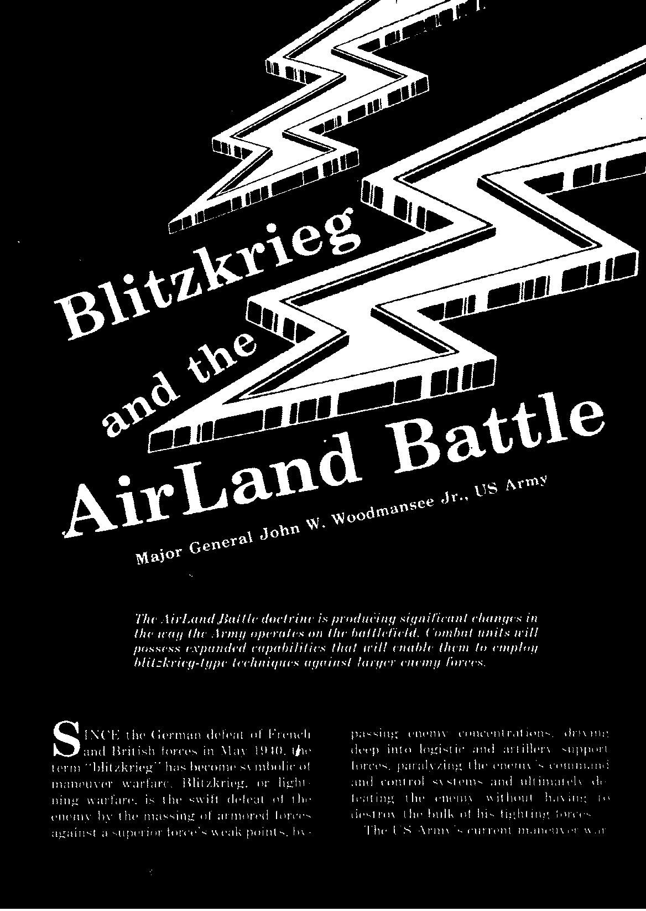
And the Germans … were very good and very brave. The soldiers of the Third Reich have many admirers. Strictly professionally of course.
These essays appeared in the Military Review the professional journal of the US Army in the 1980s.

Slide 22
But what purpose did Germany’s military professionalism serve and what was it implicated in?
Without Blitzkrieg no conquest of Poland or the Soviet Union.
Without Auftragstaktik less eager over-fulfillment of the Holocaust and any other order however obscene.
Group cohesion essential to logic of Holocaust. The bystanders are not just watching. They enforce the group’s commitment to finishing this job.

Slide 23
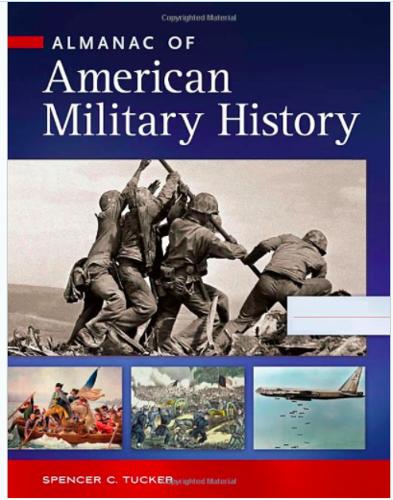
One reaction to this impasse is to revert to heroic national narratives.
Perhaps military history is ok so long as we focus on the good guys.
It is hard for this not to be a war-affirming history.
NB: No comment intended on this particular publication, but the jacket illustrations make the point.

Slide 24
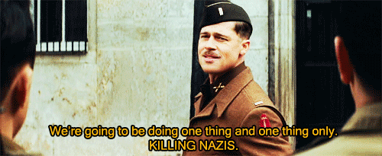
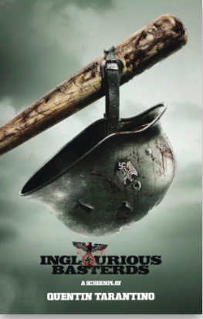
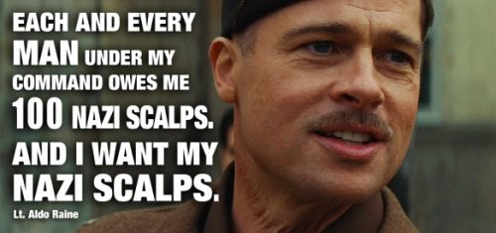
From heroic narratives it is a short step to the history of war as revenge narrative:
There we were getting comfortable with out celebration of anti-Nazi violence and damn it, he has to remind me of Andrew Jackson!

Slide 25
Military history and its impasses
Why did they start these war?
Were they always this way?
Perhaps all soldiers and states are basically the same?
Perhaps the truth is that across history all soldiers everywhere are the same
What was wrong with them?
No. So what went wrong?
Well, actually, some are better at soldiering than others and the Germans were outstanding!
Why didn’t they turn out like us?
God NO! Clearly THEY were terrible.
Ok … we will do military history, BUT only of the good guys
Does it make sense to explain the things we hate by the fact that they did not turn out like us?
By good guys … we mean killers … right? Really good killers? Really good killers for a really good cause?
This is ridiculous! These man-children with their obsession with soldiers. They need to grow up! In the mean time no one respectable should teach military history.
So you are going to teach classses that are bad social history, or tell me that all soldiers are the same, or ours are good and theirs are bad and we should glorify our killers, especially if they are good at it?

Slide 26
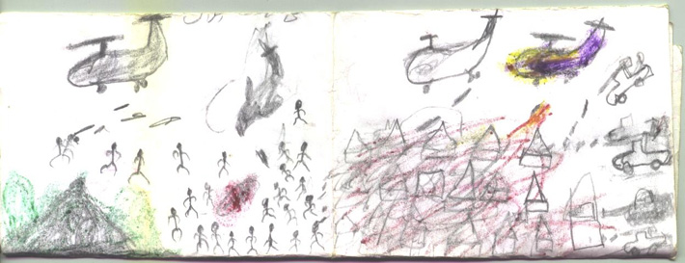
Do military historians write with crayons? – Question put to John Lynn by University of Illinois colleague.
https://tropicsofmeta.wordpress.com/2012/09/27/crayons-fraternities-and-military-historians-the-perception-and-state-of-american-military-history/
In fact, the field has undergone huge development in last fifty years. This course will deploy a wealth of material. The rest of this lecture is a short hand sketched not of that historiography but of the framework underpinning this lecture course and some of the narrative questions it will generate.

Slide 27
Let’s put aside any overhasty claims about the triumph of civilian modernity over military history.
Let’s grant that violence has been a defining feature of modernity in general and not just the German corner of it.
But rather than falling into the timeless verities and false equivalences of realism, lets insist on actually writing a history of violence which distinguishes different types, different motivations and organizations and emphasizes change over time.
What is the purpose of the violence?
How it is organized and by whom?
How it is executed?
What are its wider ramifications?
And how does it change over time.
Indeed this should extend to the very terms war and peace – peace under the threat of mutually assured nuclear destruction is not the same as peace after the Battle of Waterloo.

Slide 28
Lets treat this area of reality as we do something like the history of capitalism.
Instead of a “mode of production”, why not think of a “mode of war-making”.
Transferring the Marxian distinction between forces and relations of production we may argue that the “mode of war-making” has
1. a technological/material basis, which undergoes huge change.
2. A legal, political and cultural structure, which over the course of this course will also undergo a spectacular evolution.

Slide 29
Mounting Intensity of Battle
 | Average size of armies involved in battles | Number of cannon per combatant | Number of battles with more than 100000 combatants total
Thirty Years War 1618-1648 | 19000 | 1.5 | 1
Wars of Louis XIV 1701-1714 | 40000 | 1.75 | 7
Wars of Frederick the Great 1756-1763 | 47000 | 3.33 | 12
Wars of French revolution | 45000 |  | 12
Wars of Napoleon | 84000 | 3.5 | 37
American civil war | 54000 | 3 | 18
War of 1870 | 70000 | 3.3 | 12
Russo-Japanese war | 110000 | 3.75 | 3

Slide 30
European Army Strength 1475-1786
 | France | Spain | Dutch Rep | England | Sweden | Russia | Austria | Prussia
1475 | 40,000 | 20,000 |  | 25,000
1555 | 50,000 | 150,000 |  | 10,000
1595 | 80,000 | 200,000 | 20,000 | 30,000 | 15,000
1632 |  |  | 70,000 |  | 120,000 | 35,000
1635 | 150,000 | 300,000 | 50,000 |  | 45,000 | 35,000
1640 |  |  |  |  |  |  |  | 4,650
1655 | 100,000 | 100,000 |  | 70,000 | 70,000
1661 | 48,900
1675 | 120,000 | 70,000 | 110,000 | 15,000 | 63,000 | 130,000
1678 | 280,000 |  |  |  |  |  |  | 45,000
1680 |  |  |  |  |  | 200,000
1688 |  |  |  | 53,000 |  |  |  | 30,000
1690 | 338,000 |  | 73,000 | 80,000 | 90,000 |  | 50,000
1697 |  |  |  | 90,000
1705 | 400,000 | 50,000 | 100,000 | 87,000 | 100,000 | 170,000
1710 | 360,000 |  | 100,000 |  |  | 220,000 | 100,000 | 39,000
1717 | 110,000
1725 |  |  |  |  |  | 215,000
1738 | 115,000
1740 | 160,000 |  |  |  |  | 240,000 | 108,000 | 80,000
1756 | 330,000 |  | 39,000 |  |  | 344,000 | 201,000 | 143,000
1760 | 247,000 | 98,000 | 36,000 | 199,000 | 85,000 | 146,000 |  | 260,000
1778 |  |  |  | 100,000 |  |  | 200,000 | 160,000
1786 | 156,000 |  |  |  |  |  |  | 194,000
Source: Black, A Military revolution?

Slide 31
The Political Structures of Modern Militarism
Undisciplined mercenaries 17th century
Disciplined mercenaries
18th century standing army
Rev wars – the people in arms 1790s-1815
Impasse – revolutionary v. counter-revolutionary army 1848-1849
The army as conservative school of the nation 1860-1918
1933-1945 A nation of racial warriors
Cold War exterminism
From the 1970s the makings of a post-military society
States and nations are both produced by the mode of war-fighting and help to structure it.
War and military organization for war are modes of Vergesellschaftung (from Simmel - societal formation) or perhaps one might better say state-society formation.

Slide 32
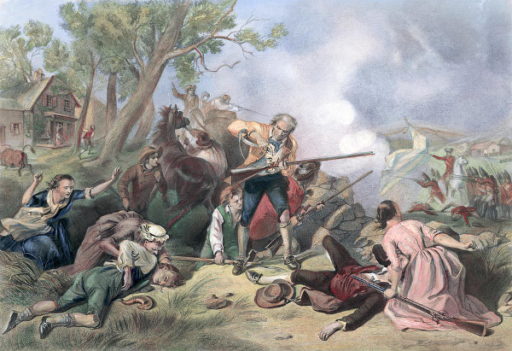
This a narrative one can trace nation by nation.
But one of the distinctive things about the mode of war-fighting is that it places powers in relation to one another.
National modes of war-making are defined by those they are counterposed to.
It is about power on power, violence on violence.
Red coats are essential to defining American minutemen.

Slide 33
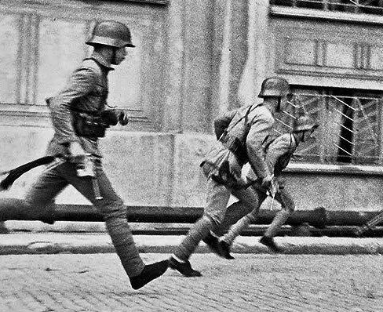
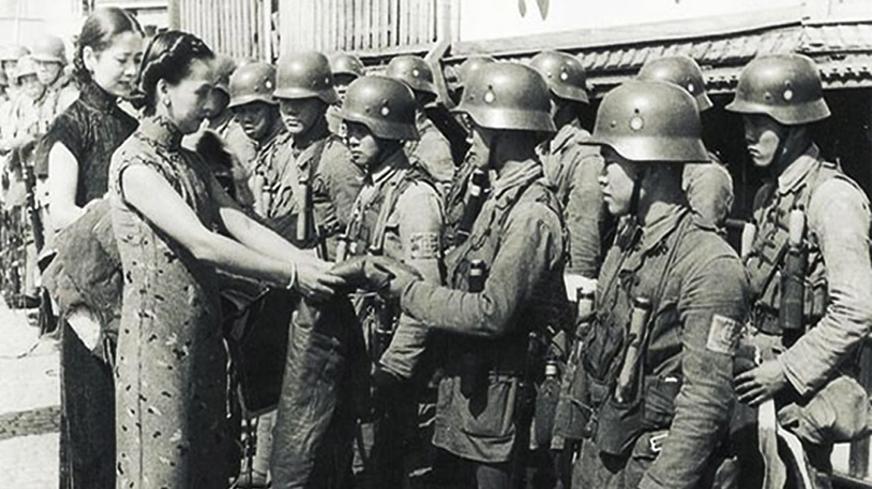
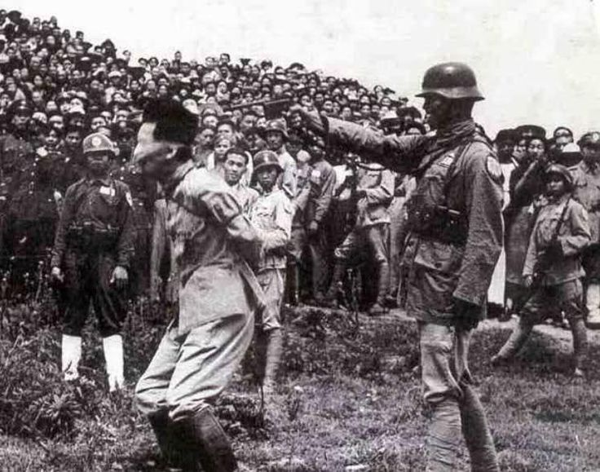
The idea of a uniform military culture or logic is a bit puzzling since the logic of the field is violent differentiation And differences are relational
For a European these images are confusing.
Chinese nationalist (NRA) soldiers, equipped and trained by Germany, in struggle with Japan Shanghai 1937 and executing Japanese war criminal 1947

Slide 34
So here’s our agenda for the term.
The question we will ask is not how Germany’s national development was mutated so as to make it warlike.
The question we will ask is how the evolving European (and global) mode of war-fighting shaped Germany and how Germany shaped that evolution, reacting on others, as they reacted back on it.
It is out of that relational and dynamic history, in which military factors interact with political and economic history, that we may be able to grasp why and how the German nation-state’s capacity for violence escalated so dramatically from the last third of the 19th century.

Slide 35
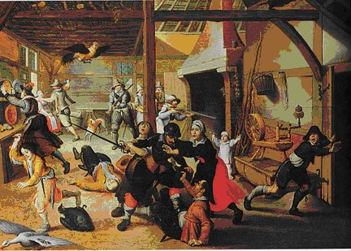
Modern European war-fighting, modern religion, modern European culture and capitalism all have an origin in the eruption of the renaissance/reformation period.
This was a period of great innovation and breakthroughs
The Germans lands – Rhineland/central/North Germany – were key participants.

Slide 36
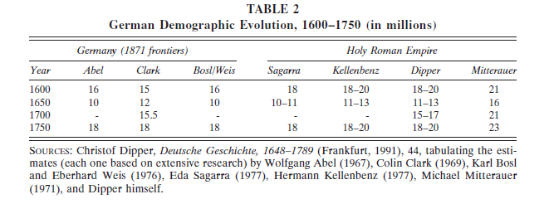
It was spectacularly innovative but as far as the German lands it was also utterly catastrophic.
We tend to think of the wars of the 20th century as being the worst to have befallen Europe. That is far from the truth at least as far as Western Europe is concerned.

Slide 37
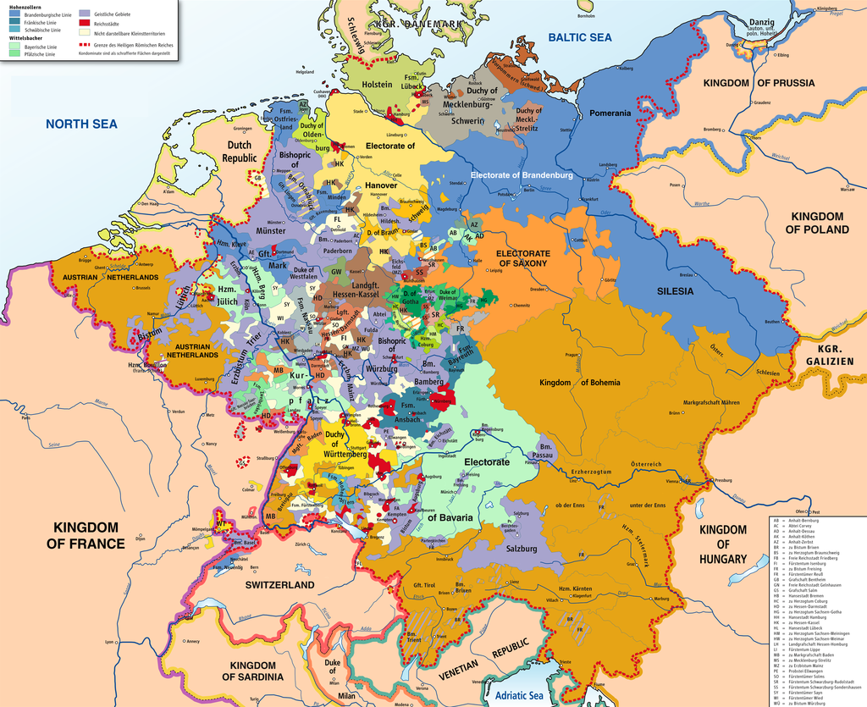
It is not just a humanitarian catastrophe. It is also the moment at which Germany’s political development separates from that of its Western neighbors. 1648 the Treaty of Westphalia left Germany as a religious and political patchwork – under umbrella of the Holy Roman Empire

Slide 38
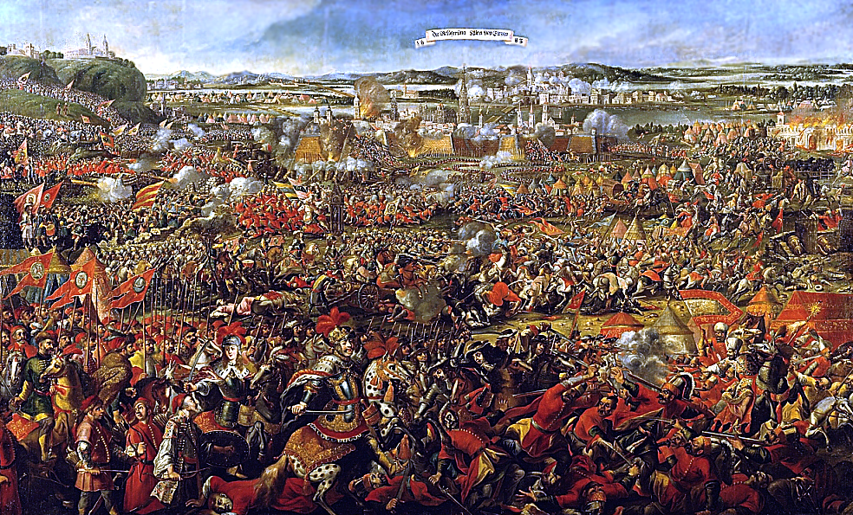
By itself the Holy Roman Empire might have functioned as a mechanism for keeping the peace in the German lands. But Germany history is never merely German history. The relational point is crucial. The Holy Roman Empire is battered from the outside.
In 1680s by expansive Ottoman Empire.

Slide 39
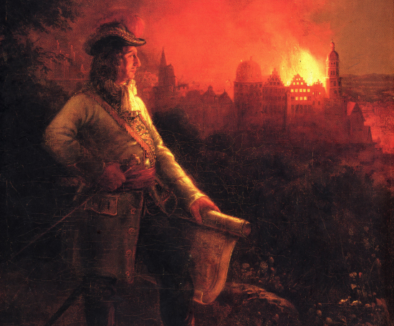
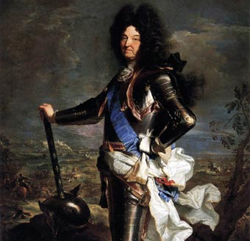
Even more menacing proved to be the emergent nation state formations to the West: France’s struggle with Habsburg rivals racks German lands
Brulez le Palatinat - 1689
Louis XIV: 1643-1715

Slide 40
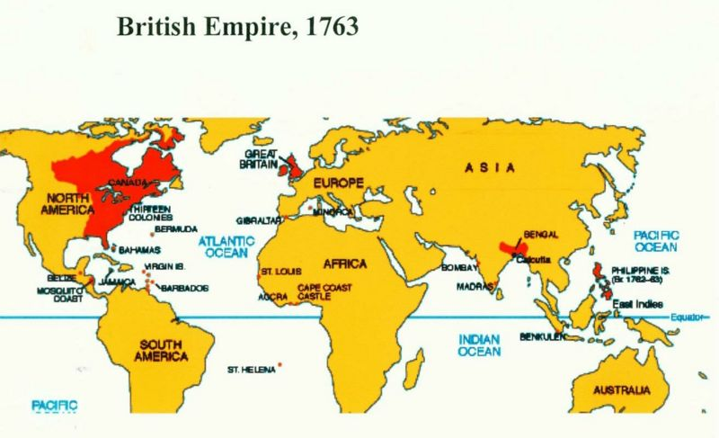
In 18th century European power politics expands dramatically beyond the boundaries of Europe: France and Britain fight a global struggle with German states as their pawns.

Slide 41
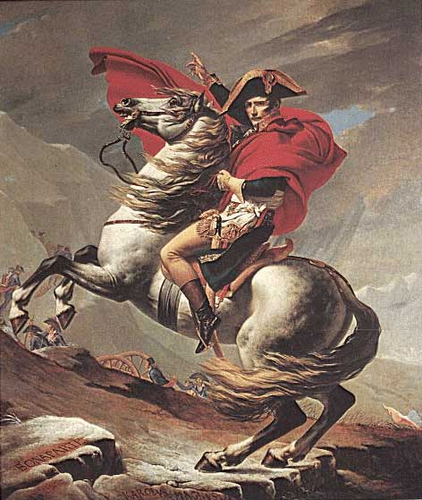

If Louis XIV was bad … Bonaparte was even worse!
French emperor arrives in Berlin 27 October 1806

Slide 42

If modern military power has a 500 year history then for the first 300 years Germans were amongst its principal victims.
It is not by accident that Germany would spawn the greatest philosopher of war, Karl von Clausewitz (1780-1831), and that his central problem was to explain Prussia’s catastrophic defeat at the hands of the French.

Slide 43

Revanche:
Bismarck, the Emperor and the German warlords in Louis XIV’s hall of mirrors at Versailles, 18 January 1871

Slide 44

Look beyond the mirrors! Look up ….

Slide 45


Versailles the Hall of Mirrors, Le Brun ceiling paintings:
(Left) Louis XIV crossing the Rhine in the face of enemies and (below) vanquishing the Germans

Slide 46


In 1870, 1914, 1939 the Germans were seen and saw themselves as fighting against the odds.
The most extensive and radical interpretation of why German fought against the odds was a particular type of geopolitical antisemitism.

Slide 47


So rather continuity, I am going to invoke an ironic inversion to explain Germany’s escalation to ultra violence: from victim to perpetrator!
But was this teleology necessary? No!
It is not for nothing that Geemany spawned not only the greatest philosopher war but also the most influential text about its abolition.

Slide 48

But Kant’s message was not easy for Germans to accept.
We think of perpetual peace as a great liberal progressive project.
Social theorists of Britain and France postulated an age of industry beyond aristocratic militarism.
But in Germany precisely because the outcome of Europe’s military history as enshrined in the Vienna Congress of 1815 was so unequal, peace was conservative.
War in Germany between the Napoleonic period and the 1850s was a revolutionary force.

Slide 49

If modern German militarism has an origin in the 19th century, it is not on iron-disciplined Prussian parade grounds, but in a desperate military rebellion of February 1813: refusing the orders of the Prussian king, calling on the people to rise up against their craven monarch and the French
The greatest revolutionary prophets of the 19th century Marx and Engels repeated the gesture in the 1840s when they called for a revolutionary war not against French but against autocratic Tsarist Russia.

Slide 50

Conservatives have always argued that the true origin of Nazism lies not in Germany’s aristocratic militarism – which furnished resistance to Hitler - but in its deviant revolutionary nationalism.

Slide 51

At the Nazi rallies in Nuremberg the army paraded in front not of the national flag or the emblems of the German state, but in front of the flags of the Nazi Party – the National Socialist German Workers Party – and the massed ranks of the Volk (race nation)
Wehrmacht is under control of a civilian regime bent on using war not for revising Versailles, or adjusting borders but total revolutionary overthrow of social and political order.

Slide 52

As such the German army and the Nazi leadership were judged together at Nuremberg.
It was in regard to Germany that liiberal international lawyers attempted to enforce not just war crimes but the outlawry of aggressive war.

Slide 53
Given Germany’s current state it might be tempting to imagine that 1945 was the end of our narrative.
But that is a misunderstanding.
Disarmament is what happened to Japan not Germany, not either of the Germanies.
The penultimate chapter of this story in the Cold War is a situation in which the World War 3 would have started with two large and heavily armed German armies, both of them based on mass conscription, fighting each other with American allies on one side and Russians on the other over the battlefields of 1944-1945.

Slide 54

The likely outcome would have been a nuclear esacalation to the end of the world.
If Germany abandoned its independent military history it was on the basis of a international configuration that more or less guaranteed that if Germany was infringed the world would be brought to an end by a nuclear inferno.

Slide 55
That stand off ended in 1989 and no one was more delighted than the Germans.
Not only unified but no longer threatened with being made once more into the battlefield of a global civil war = a return to Thirty Years War.
If there is anyone who believed in the end of history it was the Germans.
American neoconservatives turned this into a legitimation for aggressive efforts regime change. They wanted to complete their victory.
By contrast, Germany disarmed. As did most of the rest of Europe. Conscription phased out.

Slide 56


Tension with US over Iraq war of 2003 was greater than at any time since the 1980s
Since the beginning of 21st century tensions have multiplied.
Germany has struggled to contain the fallout from the Ukraine crisis since 2013

Slide 57

Imagine what it feels like in Berlin today to read the following lines from the Trumpian national security strategy issued in December 2017.
“Since the 1990s, the United States displayed a great degree of strategic complacency. We assumed that our military superiority was guaranteed and that a democratic peace was inevitable. We believed that liberal-democratic enlargement and inclusion would fundamentally alter the nature of international relations and that competition would give way to peaceful cooperation.”
“The United States must consider what is enduring about the problems we face, and what is new. The contests over influence are timeless. They have existed in varying degrees and levels of intensity, for millennia. Geopolitics is the interplay of these contests across the globe. But some conditions are new, and have changed how these competitions are unfolding. We face simultaneous threats from different actors across multiple arenas— all accelerated by technology. The United States must develop new concepts and capabilities to protect our homeland, advance our prosperity, and preserve peace.”

Slide 58
“… after being dismissed as a phenomenon of an earlier century, great power competition returned. China and Russia began to reassert their influence regionally and globally. Today, they are fielding military capabilities designed to deny America access in times of crisis and to contest our ability to operate freely in critical commercial zones during peacetime. In short, they are contesting our geopolitical advantages and trying to change the international order in their favor.”
The United States declares that history as great power competition, which has been so dangerous and disastrous for Germany, is back!

Slide 59

This isn’t merely academic history.
I designed this course as a pedagogic response to the intellectual atmosphere at Yale that had internalized Obama’s “forever war”. My aim was to offer a response by narrating the history of a country for which war was no longer a means of statecraft.
Today I should probably end by calling to mind that it is not inconceivable that this term will be interrupted by a nuclear exchange between this country and North Korea in which South Korea which I imagine is some of your homeland will be a principal victim.
An outcome in other words very much like that which menaced West Germany until 1989.

